Slide 1
CREDENTIALING THE DRUG DEMAND REDUCTION WORKFORCE
by
Tay Bian How , Director ICCE

Slide 2
Global Drug Use
246 million between the ages of 15 and 64 years used an illicit drug in 2013
27 million drug users suffer from SUD or drug dependence
12.19 million inject drugs, out of which 1.65 million are living with HIV
187,100 drug-related deaths annually
World Drug Report 2015

Slide 3
Establishment of ICCE
Rationale:
High prevalence of drug use
High relapse rate
Lack of evidence-based prevention and treatment services
Dearth in trained DDR staff
Lack of standardised curricula for DDR professionals
16 February 2009
263rd Colombo Plan
Council Session

Slide 4
ICCE Goals
To create an international cadre of addiction professionals by enhancing their knowledge, skills and competence, thereby enabling them to provide quality services and care for their clients and families
To provide a global standard that encourages addiction professionals to continue learning for the purpose of providing quality services to their clients
To focus on the individual addiction professional and to provide a formal indicator of the current knowledge and competence
To promote professional and ethical practice by adhering to a code of ethics

Slide 5
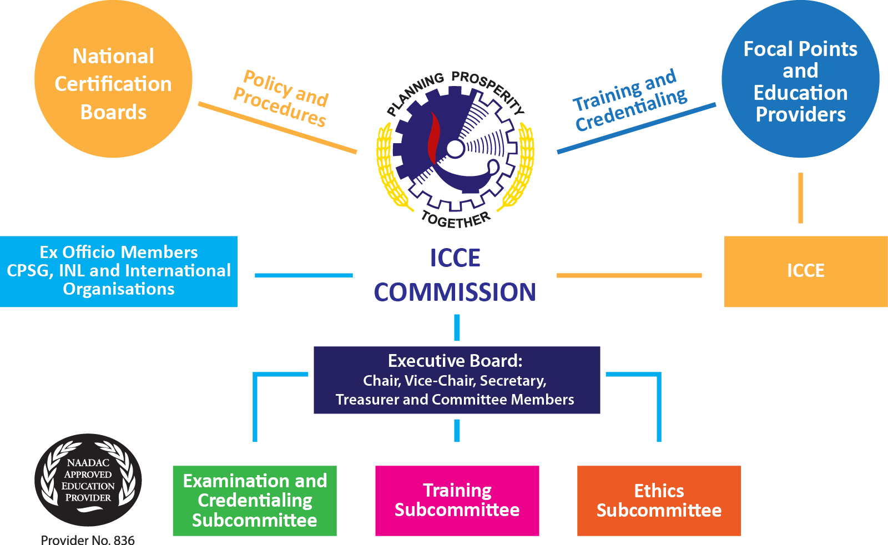
ICCE Commission

Slide 6
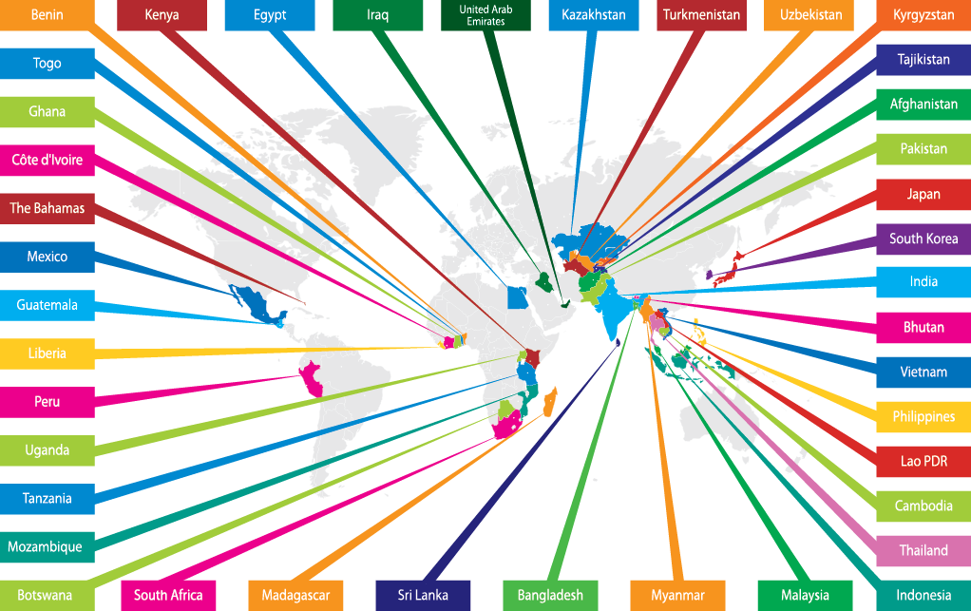

Slide 7
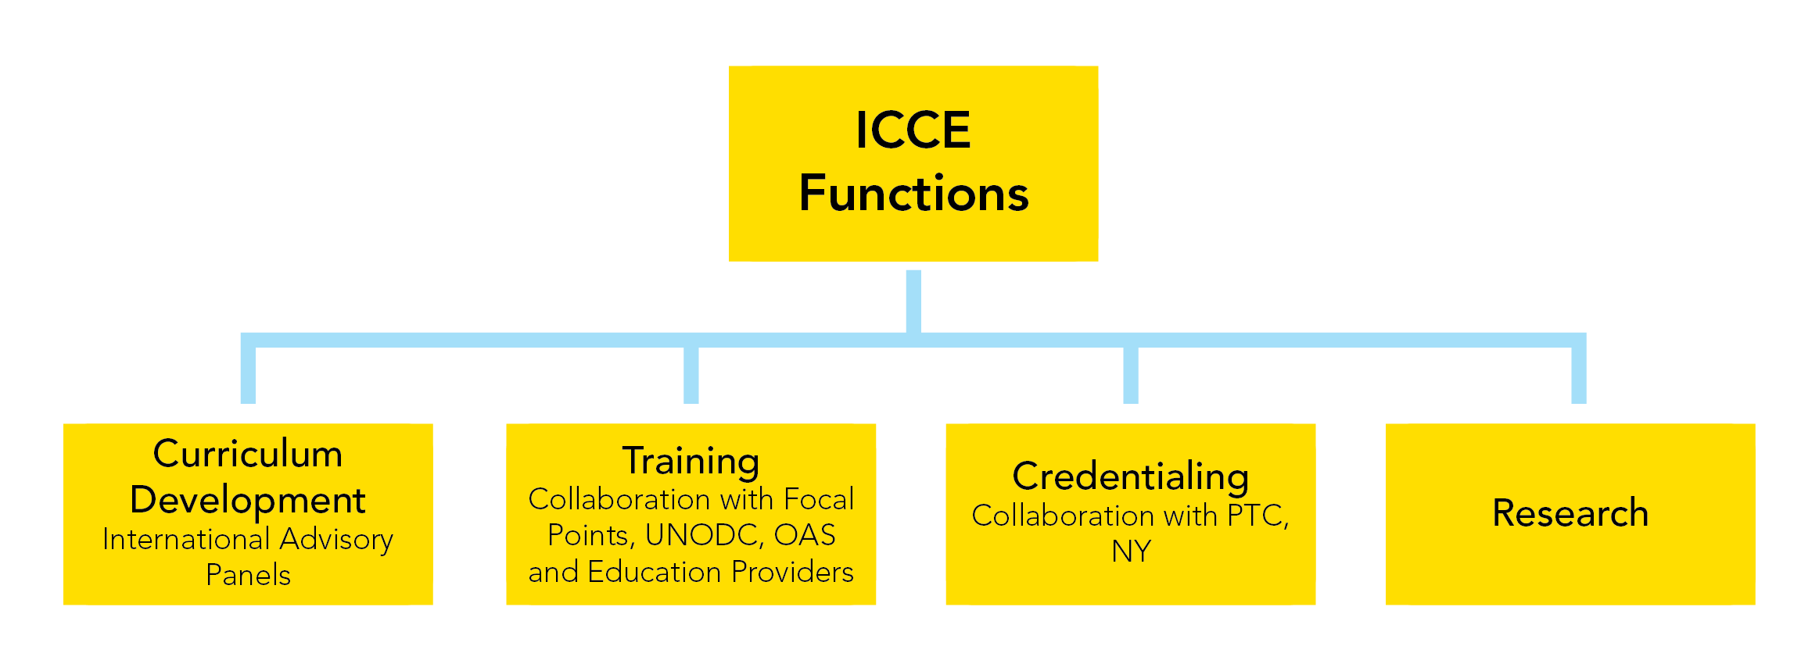
ICCE Functions

Slide 8
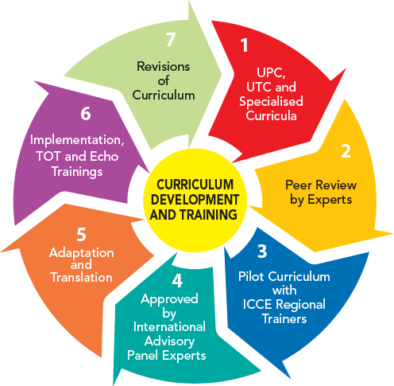
ICCE Curriculum Development and Training
Development of evidence-based curriculum
Review of curriculum by experts or trainers before implementation
Pilot-testing of curriculum
Endorsement of curriculum by Expert Advisory Group (INL, IOs and Experts)
Adaptation and Translation of curriculum into local language of participating country
Implementation of TOTs and Echo Training
Revision of curriculum (2-3 years)

Slide 9
Curriculum Development
Curriculum developed based on science
Curriculum piloted, tested and adapted to suit the culture, religion and region
Curriculum reviewed by experts or trainers before implementation
Curriculum endorsed by Expert Advisory Group (INL, IOs and Experts)
Curriculum translated into the local language of participating countries
ICCE does not train without a curriculum

Slide 10
UPC-1 Curriculum | Status | Date of Completion
1- Introduction to Prevention Science | Printed/Available | March 2015
2-Physiology & Pharmacology | Printed/Available | March 2015
3-Monitoring and Evaluation | In production Est. production | June 2015 August 2015
4-Family-Based Prevention Interventions | Revisions done Est. production | June 2015 Oct. 2015
5-School-Based Prevention Interventions | Printed/Available | June 2015
6-Workplace-Based Prevention Interventions | Printed/Available | May 2015
7-Environment-Based Prevention Interventions | In APS formatting Est. production | July 2015 Oct. 2015
8-Media-Based Prevention Interventions | In APS formatting Production | June 2015 Sept. 2015
9-Community-Based Prevention Implementation Systems | Revisions est. Est. production | August 2015 Nov. 2015

Slide 11
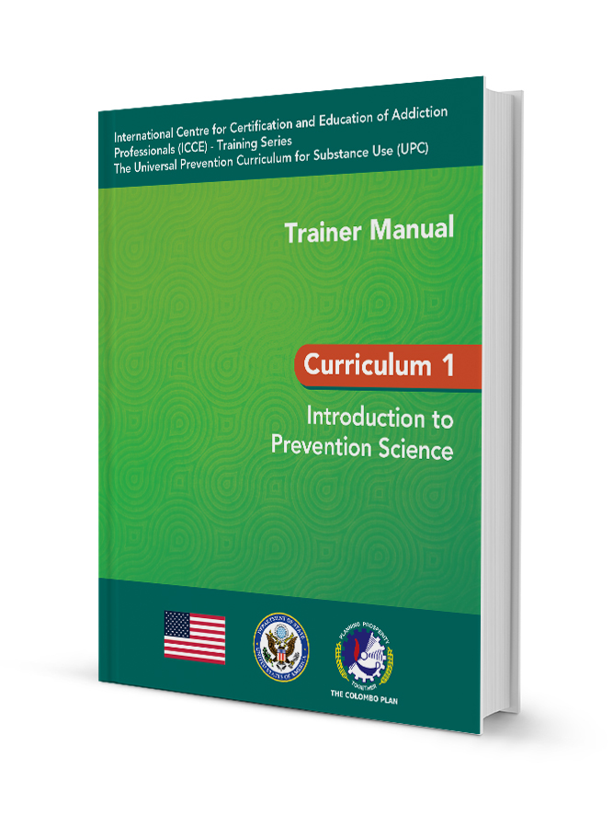
Curriculum Development – UPC Series 2
Track 1: School-based Prevention
Track 2: Family-based Prevention
Track 3: Environment-based Prevention
Track 4: Media-based Prevention
Track 5: Workplace-based Prevention
Track 6: Community-based Prevention Implementation Systems
Track 7: Monitoring and Evaluation

Slide 12
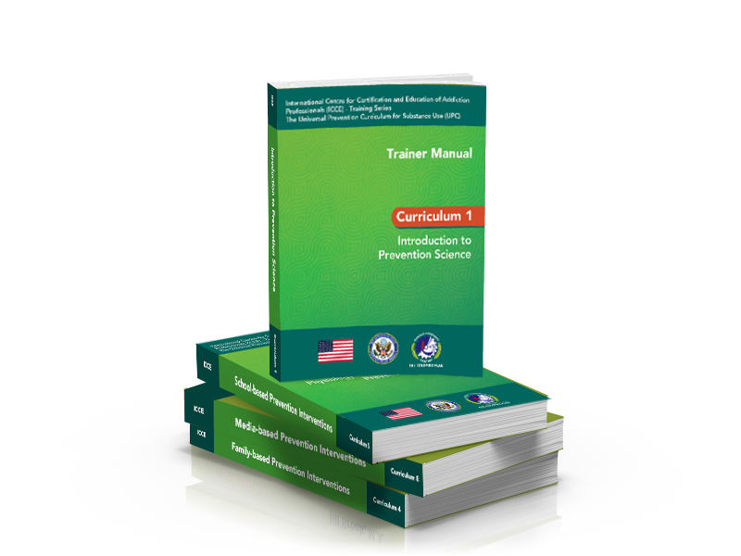
Curriculum Development - UPC
UPC Series ll (Implementer Level)
In 2015, APS curriculum developers writing the 7 prevention tracks (45 curricula)
Core curriculum (8-10 days)
Introduction to prevention Science
Physiology and Pharmacology for prevention specialists
Monitoring and evaluation

Slide 13
UPC-Series 2
UPC-1 Curriculum | Venue | Pilot Testing | Revision
School-Based Track (140 hours) | Dubai, UAE | April 2016 | June 2016
Family-Based Track (140 hours) | Dubai, UAE | April 2016 | June 2016
Environment-based Track (110 hours) | Dubai, UAE | May 2016 | July 2016
Media-based Track (115 hours) | Dubai, UAE | May 2016 | July 2016
Workplace-based Track (130 hours) | Dubai, UAE | June 2016 | August 2016
Community-based Track (150 hours) | Dubai, UAE | June 2016 | August 2016
Monitoring and Evaluation Track (100 hours) | Dubai, UAE | July 2016 | September 2016

Slide 14
Curriculum | Status | Date of Completion
1- Physiology & Pharmacology for Addiction | Revised | March 2015
2-Treatment for Substance Use Disorders- The Continuum of Care | Revised | March 2015
3-Common Co-occurring Mental and Medical Disorders | Revised | May 2015
4-Basic Counseling for Addiction Professionals | Revised | March 2015
5-Intake, Screening, Assessment, Treatment Planning and Documentation for Addiction Professionals | Finalised | May 2015
6- Case Management for Addiction Professionals | Revised | March 2015
7 –Crisis Intervention for Addiction Professionals | Revised | March 2015
8 –Ethics for Addiction Professionals | Revised | March 2015

Slide 15
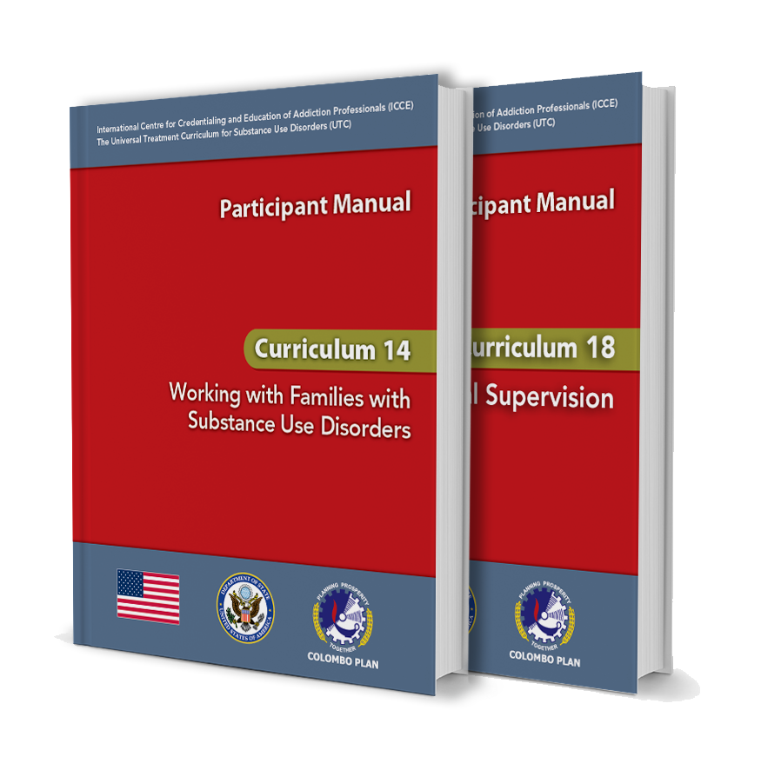
CURRICULUM DEVELOPMENT – UTC Intermediate Level
Curriculum 9 : Pharmacology and Substance Use Disorders (SUD)
Curriculum 10: Managing Medication-Assisted Treatment Programmes
Curriculum 11: Enhancing Motivational Interviewing (MI) Skills
Curriculum 12: Cognitive Behavioural Therapy (CBT)
Curriculum 13: Contingency Management
Curriculum 14: Working with Families
Curriculum 15: Skills for Screening Co-occurring Disorders
Curriculum 16: Intermediate Clinical Skills and Crisis Management
Curriculum 17: Case Management Skills and Practices
Curriculum 18: Clinical Supervision for SUD Professionals

Slide 16
UTC Intermediate Level
Curriculum | Status | Date of Completion
9- Physiology & Pharmacology for SUD | Being developed | September 2015
10-Managing Medication-Assisted Programs | Being developed | September 2015
11- Enhancing Motivational Interviewing Skills | Being developed | September 2015
12 – Cognitive Behavior Therapy | Being developed | September 2015
13- Contingency Management – A Reinforcement-based Treatment | Being developed | September 2015
14- Working with Families | Pilot tested/Revised | June 2015
15-Skills for Diagnosing COD | Being developed | September 2015
16- Intermediate Clinical Skills and Practices | Being developed | September 2015
17 – Crisis Management | Being developed | September 2015
18- Clinical Supervision Skills | Pilot tested/Being Revised | September 2015

Slide 17
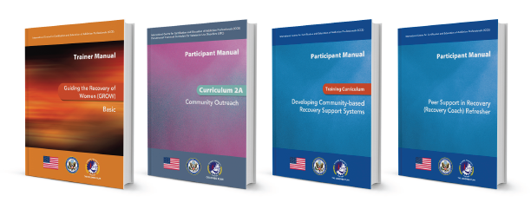
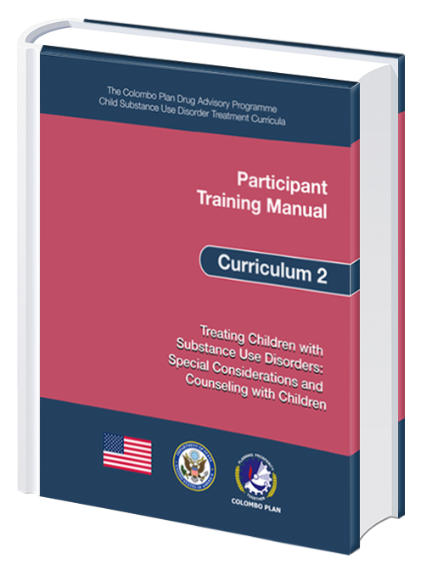
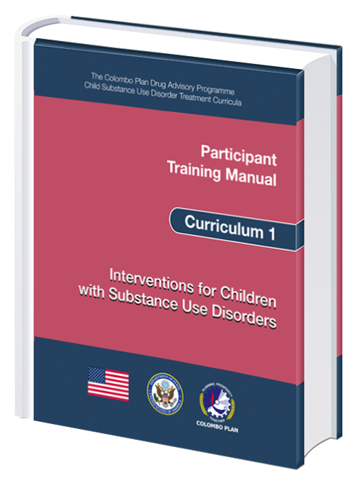
Curriculum Development - UTC Specialised Curricula
Guiding Recovery of Women (GROW) – 10 Curricula
Community Outreach (CO) – 1 Curriculum
Developing Community-based Recovery Support Systems (CRSS)– 2 Curricula
Child Addiction – 6 Curricula

Slide 18
Specialised Curricula: Guiding Recovery of Women
Curriculum | Status | Date of Completion
1 - GROW Basic | Revised (2nd Edition) | October 2014
2 - GROW Treatment Interventions for Women with Domestic Violence Experience | Revised (2nd Edition) | October 2014
3 - GROW Treatment Interventions for Women with COD | Revised (2nd Edition) | October 2014
4 - GROW Treatment Interventions for Pregnant Addicted Women | Revised (2nd Edition) | October 2014
5 - GROW Treatment Interventions for Women with Trauma | Revised (2nd Edition) | October 2014
6 - GROW Treatment for Women with Children | Revised (2nd Edition) | October 2014
7 - GROW Treatment Interventions for Adolescent Girls | Revised (2nd Edition) | October 2014
8 - GROW Substance Abuse Treatment and Family Therapy | Revised (2nd Edition) | October 2014
9 - GROW Relapse Prevention Treatment for Women | Revised (2nd Edition) | October 2014
10 - GROW Understanding the Continuum of Care Needs of Women in Recovery | Revised (2nd Edition) | October 2014

Slide 19
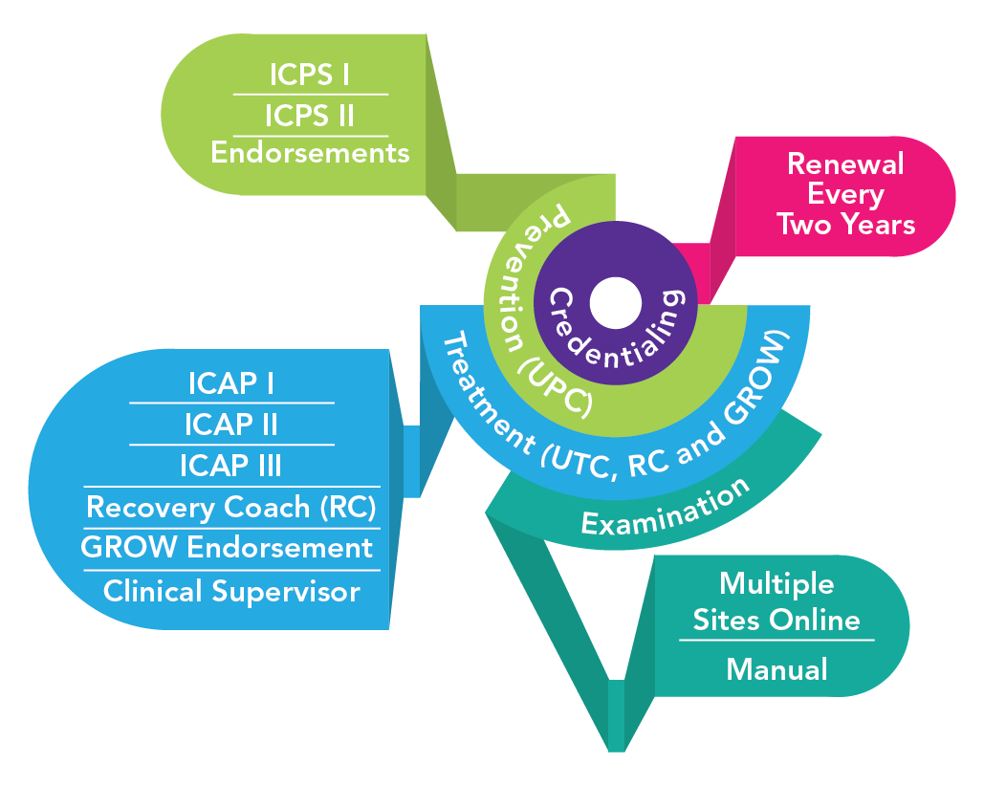
Credentialing

Slide 20
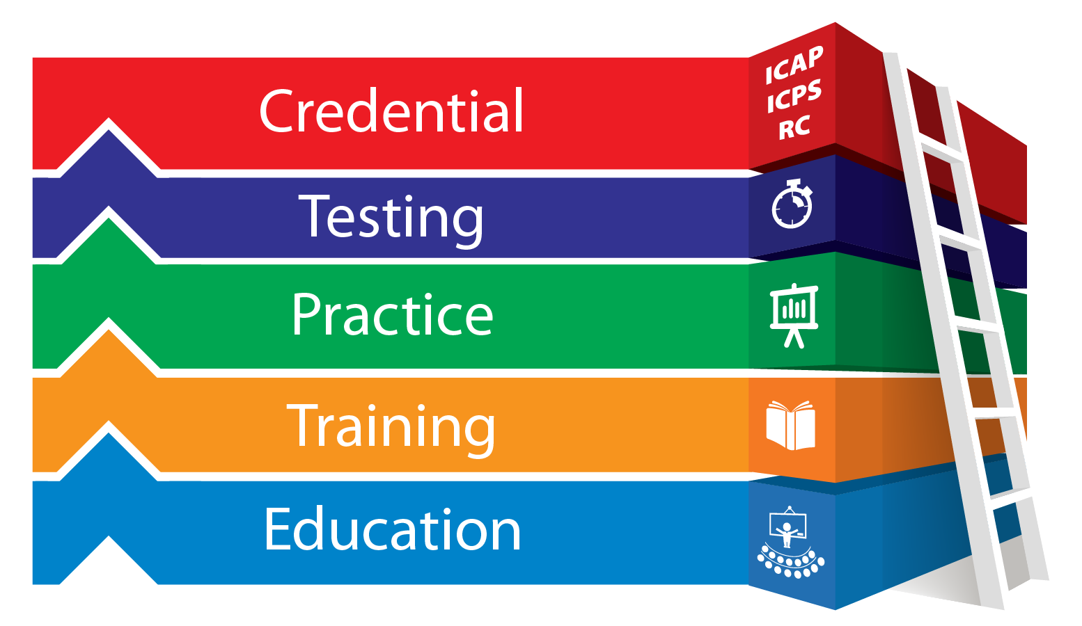
Credentialing
The validation of skills, knowledge and competence through application and testing of addiction professionals
Training and education are the basis for credentialing

Slide 21
Rationale of Credentialing
Necessary knowledge, skills and capability to deliver the demanding work agenda
Health care professions have never been static
Specialisation
Reaction to the changing employment market
License to practise

Slide 22
Collaboration with International Credentialing Agencies

Slide 23
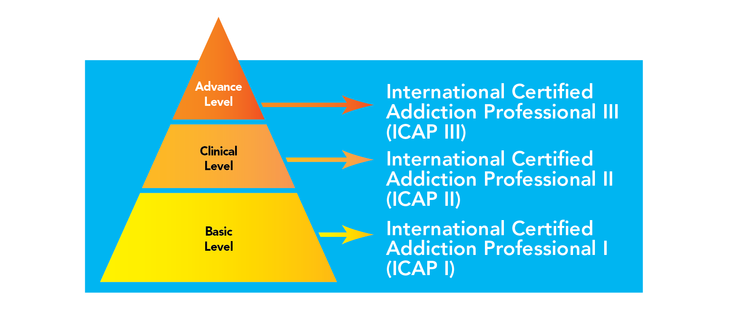
ICCE Credentials

Slide 24
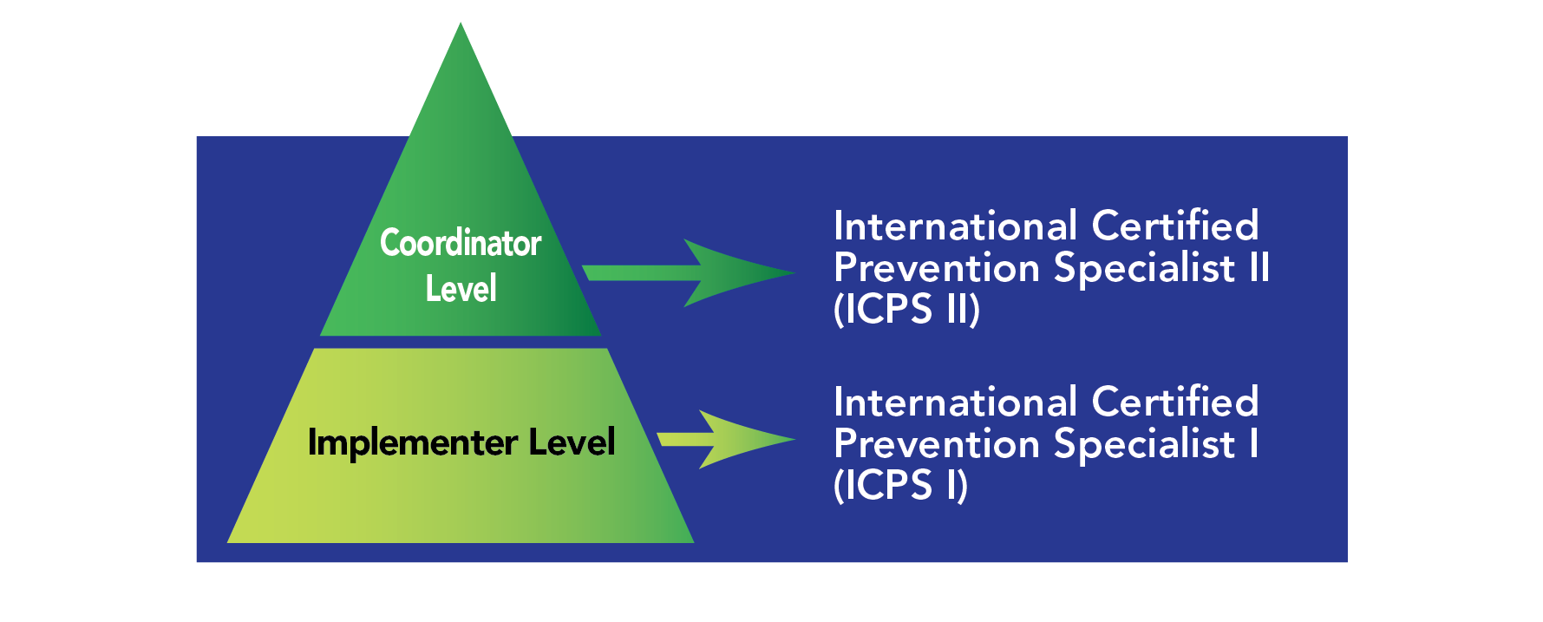
ICCE Credentials

Slide 25
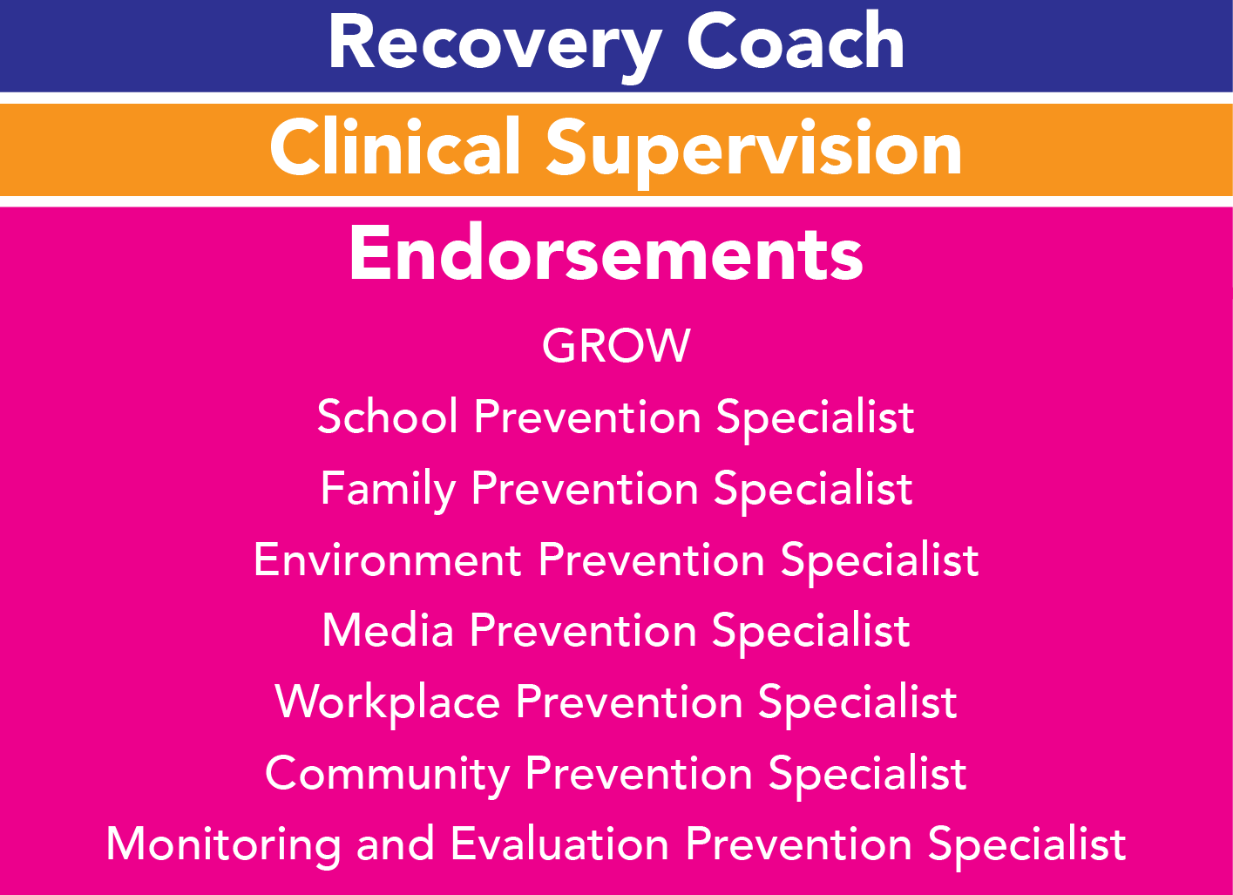
ICCE Credentials and Endorsements

Slide 26
Examination Development
Questions are written by global master trainers based on the domains in the examination
Reviewed and approved by curriculum developers and subject matter experts
Three cycles of review before finally approved
Regularly updated and reviewed periodically to ensure they address the latest information in the field

Slide 27
Number of Questions by Credential
Credential | No. of Questions | No. of Hours
ICAP I | 125 | 3
ICAP II | 175 | 3
ICAP III | 225 | 4
RC | 100 | 3
ICPS I | 125 | 3
ICPS II | 175 | 3.5

Slide 28
ICPS Credentials and Eligibility Criteria
^{Credential} | ^{Eligibility Criteria}
ICPS I | Supervised working experience of two years in the prevention field (3,000 hours), and possess a bachelor’s degree, or Supervised working experience of five years(7,500 hours) in the prevention field and possess a high school diploma
ICPS Il | Supervised working experience of five years ( 7,500 hours) in the prevention field, and possess a master degree, or Supervised working experience of seven years(10,500 hours) in the prevention field and possess a high school diploma
Endorsement | One year working experience in the specialised prevention track or 1,500 hours of supervised working experience. 120 continuing education hours in any of the prevention track Must possess the ICPS I prior to acquiring the endorsement in a specialised track, such as school, workplace, family, media, etc.

Slide 29
Eligibility Criteria For ICAP & Recovery Coach
^{Credential} | ^{Eligibility Criteria}
ICAP l | 1 year of full time or 1,500 hours of supervised work experience, High school education, 120 contact hours education
ICAP ll | 2 years of full-time or 3,000 hours of supervised experience, Bachelor degree, 240 contact hours of education
ICAP lll | 5 years of full-time or 7,500 hours of supervised experience, Master degree, 500 contact hours of education
Recovery Coach (RC) | 1 year of supervised work experience in substance use disorders, High School education,100 contact hours of education

Slide 30
Eligibility Criteria For Clinical Supervision
Forty-five (45) hours of didactic and experiential training in clinical supervision
Possess ICAP II credentialing
Three (3) years and not less than 4,500 hours of supervised employment as a Substance Use professional
200 hours of face-to-face clinical supervision received
One year of experience as a full time Clinical Supervisor

Slide 31
Renewal of Credentials
Every two to three years with 40 continuing education hours and renewal fee

Slide 32
Benefits of Credentialing
Validation of the skills, knowledge and competencies of the workforce
Declaration of the individual's competencies and thus enhancing their employability and career advancement
Ascertaining the quality of addiction prevention, intervention, treatment and aftercare services to be standardized
Setting a benchmark for addiction and prevention professionals

Slide 33
What the Participants Say
Motivation and Expectations “The training makes me mature and helps me find out what’s lacking in my own recovery”
Focus Group Discussion, Cebu, 2013

Slide 34
What the Participants Say
Defining the Role of SUD Counsellors
“By systematic learning, I know what I need to know and based on the knowledge, I know now, what I should do and should not do in the field”
Focus Group Discussion, Cebu, 2013

Slide 35
What the Participants Say
Opportunity to Evaluate Performance
“Helps me to communicate with other professionals with confidence”
Focus Group Discussion, Cebu, 2013

Slide 36
What the Participants Say
Sign of Success: Open Door
“It would allow me to do what I love, and it would be a sign of success”
Focus Group Discussion, Cebu, 2013

Slide 37
What the participants say
Validation, Affirmation and Recognition
“If I get credentialed through a prestigious organisation like CP, it would protect me and give me credibility”
Focus Group Discussion, Cebu, 2013

Slide 38
Calculation of Continuing Education Hours
Programme | Number of Hours | Documents to be Submitted
Training Courses attended in last 5 years | 6 hours of continuing education for each training day. The training should be recognised by ICCE Commission. | Certified true copies of the training programmes attended in last 5 years.
Training courses conducted | Numbers of training hours + 1 hour preparation time for each 2 hours of training. However preparation time for same training topics will be counted once in 2 years. | Details to be verified by the Employer/Supervisor

Slide 39
Calculation of Continuing Education Hours Cont…
Tertiary Education | General Subjects | Relevant Subjects
Pre-diploma | 10 hours | 20 hours
Bachelor Degree | 20 hours | 40 hours
Post Graduate Diploma | 30 hours | 60 hours
Masters | 40 hours | 80 hours
PhD | 50 hours | 100 hours

Slide 40
ICCE Code of Ethics
“All addiction professionals applying to be credentialed through ICCE are required to sign the “Ethical Guidelines for ICCE addiction professionals on the day they take the ICCE examination”

Slide 41
ICCE Examinations Conducted (as of April 2015)
No | Venue | Date | Number of Candidates
01 | Jakarta, Indonesia | 6th June 2012 | 35
02 | Bangkok, Thailand | 29th July 2013 | 48
03 | Chennai, India | 20th January 2014 | 24
04 | Johor Bahru, Malaysia | 20th June 2014 | 54
05 | Colombo, Sri Lanka | 2nd December 2014 | 23
06 | Chennai, India | 7 April 2015 | 28
07 | Nairobi, Eldoret, Mombasa, Kisumu and Nyeri in Kenya | 10 April 2015 | 101
08 | Jakarta, Indonesia | 25 April 2015 | 111
09 | Bangkok, Thailand | 11 July 2015 | 94
 | Total |  | 518

Slide 42
ICCE Credentials by Country (as of April 2015)
No. | Country | ICAP 1 | ICAP II | ICAP III | RC | Total
1 | Afghanistan | 15 |  |  |  | 15
2 | Bangladesh | 1 |  |  |  | 1
3 | Bhutan | 3 |  |  |  | 3
4 | Germany | 1 |  |  |  | 1
5 | India | 8 | 13 | 3 |  | 24
6 | Indonesia | 59 | 12 |  | 6 | 77
7 | Japan |  |  |  | 1 | 1
8 | Kenya | 45 | 55 | 1 |  | 101
9 | Malaysia | 3 | 1 | 1 | 1 | 6
10 | Maldives | 10 |  |  | 1 | 11
11 | Pakistan | 6 | 3 |  |  | 9
No. | Country | ICAP 1 | ICAP II | ICAP III | RC | Total
12 | Philippines | 20 | 7 | 2 | 14 | 43
13 | Singapore | 1 | 1 |  |  | 2
14 | South Africa | 1 |  |  |  | 1
15 | South Korea | 8 |  | 1 |  | 9
16 | Sri Lanka | 6 | 1 |  |  | 7
17 | Thailand | 2 | 2 |  | 3 | 7
18 | UAE | 1 |  |  |  | 1
19 | USA |  |  | 3 |  | 3
20 | Uzbekistan | 1 |  |  |  | 1
 | Total | 191 | 95 | 11 | 26 | 323

Slide 43
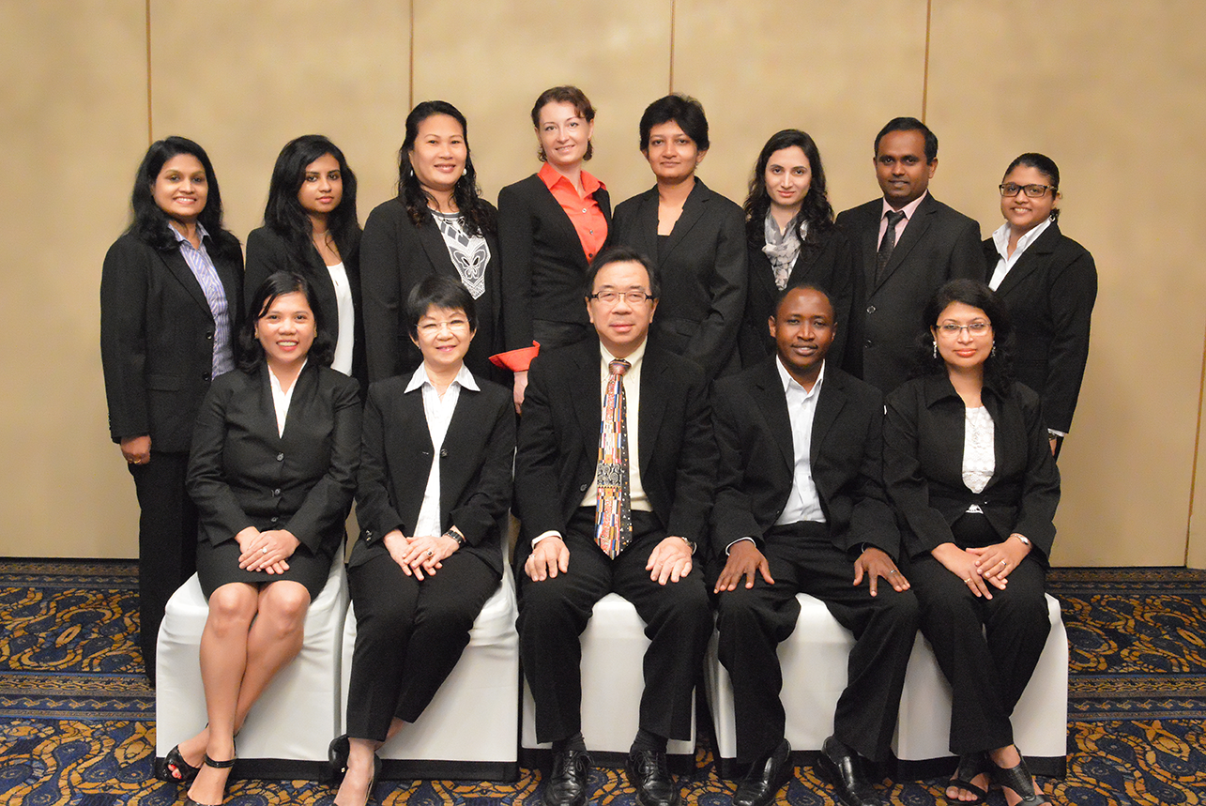
In Conclusion…
ICCE envisions to be the leading global credentialing organisation of DDR professionals who enhance the health and well-being of individuals, families and communities
For more details, kindly write to:
Email: icceinfo@colomboplan.org

