Slide 1

Adolescent Development

Slide 2
ADOLESCENT DEVELOPMENT
Methodology:
Active discussion
Case Study
Role Play
Required Materials:
Easel Pad
Participant Manual
Notepad for each participant
Pens & Pencils
Duration: 4 hours
Notes:
The trainer will point out the methodology for this training. Active discussion refers to the trainer’s lecture but also participation from the audience in the form of questions, comments, suggestions that will enhance mutual learning.
The required materials for this module provide preparation for exercises.
The expected duration of this module is two hours.

Slide 3
ADOLESCENT DEVELOPMENT
Learning Objectives
  To conceptualize the adolescence experience.
  To learn about stages of adolescent development at the physical, emotional, cognitive, mental, and psychological levels.
  To learn about the adolescent brain and most recent research on development.
Notes:
The trainer will introduce the learning objectives. But first, the trainer can ask the audience what their expectations are about this module.
Learning Objectives
To conceptualize the adolescence experience.
To learn about stages of adolescent development at the physical, emotional, cognitive, mental, and psychological levels.
To learn about the adolescent brain and most recent research on development.

Slide 4
ADOLESCENT DEVELOPMENT
  Learning Objectives continued…
  To review the bio-psychosocial model
  To understand the impact of substance use/abuse's on neurological development.
  To learn about developmental factors that promote wellness in youth.
Notes:
The trainer will continue pointing out the learning objectives of this module.
Learning Objectives continued…
To review the bio-psychosocial model
To understand the impact of substance use/abuse's on neurological development.
To learn about developmental factors that promote wellness in youth.

Slide 5

ABOUT ADOLESCENT DEVELOPMENT
Adolescence is a period of transition between childhood to adulthood.
“Window of opportunity” concept.
Cultural expression of adolescent development.
  Examples: Quinceañeras in the Americas.
(Britanica.com, 2019; GlobalCitizen.com, 2020)
Notes:
The trainer will introduce the topic of adolescent development by discussing facts about adolescence.
Adolescence is a period of transition between childhood to adulthood: children at this stage go through tremendous changes. During this time, the changes can be confusing and overwhelming, thus cause emotional and behavioral patterns that signal stress. Children at these stages need consistent guidance and support. Young adolescents are particularly vulnerable when they are still developing.
“Window of opportunity” concept: There are two windows of opportunity in human beings for maximum and rapid development; from birth to three and during adolescence. This is when the most intense brain development happens in a human being.
Cultural expression of adolescent development.
Examples: Quinceañeras in the Americas refers to a festivity where a young teenage girl is presented in society as a woman. Some of the rituals include; a religious mass, a reception, a choreographed dance and some symbolic rituals include the young girl passing down a doll to a younger sibling, the same way she is leaving behind her childhood. This festivity comes from a combination of indigenous rituals and the introduction of Catholicism in the Americas.
Let’s discuss what are some rites of passages for adolescents in your context.

Slide 6
Let’s discuss some examples of rite of passages in your context and other cultures
(Britanica.com, 2019; GlobalCitizen.com, 2020)
Notes:
The trainer will engage the group in conversation about examples they know in their context or rituals they have heard about from other cultures. The goal of this small exercise is to increase cultural awareness of how adolescents might experience their expectations in society.
The trainer can also provide these examples:
Jewish Tradition: Bar and Bat Mitzvah
In the Jewish coming of age tradition, young boys and girls celebrate their Bar and Bat Mitzvahs at age 13 and 12 in order to demonstrate their commitment to their faith. It is a major symbol for teenagers to prove to society that they are faithful to the Jewish Law.
Khatam Al Koran Tradition: Malaysia
In Malaysia, at age 11 Muslim girls celebrate Khatam Al Koran. Young girls spend years preparing for this event which demonstrates to society their growing maturity at their local mosque. In a large ceremony, girls recite the last chapter of the Koran to family, friends and society.
Japanese Tradition: Seijin-no-Hi
In Japan, the second Monday of January marks a special day- the day in which 20 year olds get to dress up in their finest traditional attire, attend a ceremony in local city offices, receive gifts, and party to their hearts’ content amongst friends and family. It’s their Coming of Age Festival, otherwise known as Seijin-no-Hi.

Slide 7
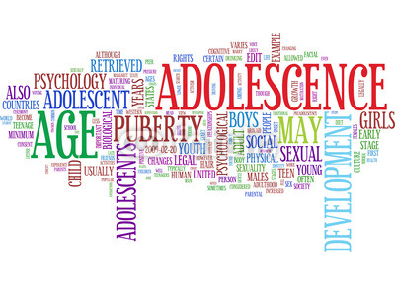
DOMAINS OF DEVELOPMENT
Notes:
The trainer will introduce the types of development and will point out that each will be discussed in the following slides. The trainer should say that we will heavily discuss the physical development at the biological and neurological level. Then we will go through the typical stages of adolescence.

Slide 8
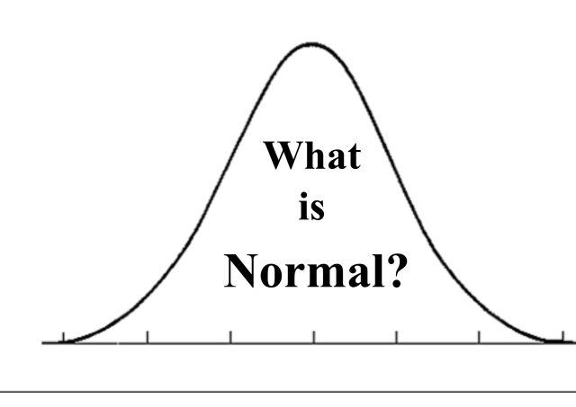
ADOLESCENT DEVELOPMENT EXERCISE
Is it normal that adolescents to...
  Argue just because they want to?
  Jump to conclusions?
  Be self-centered?
  Constantly find adults wrong?
  Be dramatic?
(APA, 2002)
Notes:
The trainer will conduct a small exercise where each participant will raise their hand if they find the statement to be true. The trainer will call on those who raise their hand to explain why they believe their position. Then the trainer will explain the research behind the statements. All statements are true. This exercise should take about 20 minutes.
Is it normal that adolescents to...
Argue just because they want to? Adolescents are practicing cognitive skills that help them see both sides of a problem, therefore they might go on tangents and also might contradict themselves, this can be frustrating for adults but it is necessary that they practice these skills.
Jump to conclusions? Adolescents are more likely to jump to conclusion as they’re continuing to learn how to have complex conversations. The shame of being wrong can be highly stressful for the adolescent.
Be self-centered? Adolescents are just becoming aware of themselves, their identities and their place in the world. Therefore they think about themselves a lot and it happens at home, school and with peers. Thinking about others is a skill they’re learning as well and should be encouraged.
Constantly find adults wrong? Adolescents are becoming aware of the flaws in adults and the world. Therefore, they will challenge adult’s positions more often as they have a need to understand the complexity of situations.
Be dramatic? Everything in their development is just beginning as we will learn in the next slides. This can be a confusing time and can lead to strong expressions of their feelings. Adults carry larger responsibilities that adolescents don’t and might not place importance on the adolescents’ problems, making the adolescent frustrated.

Slide 9
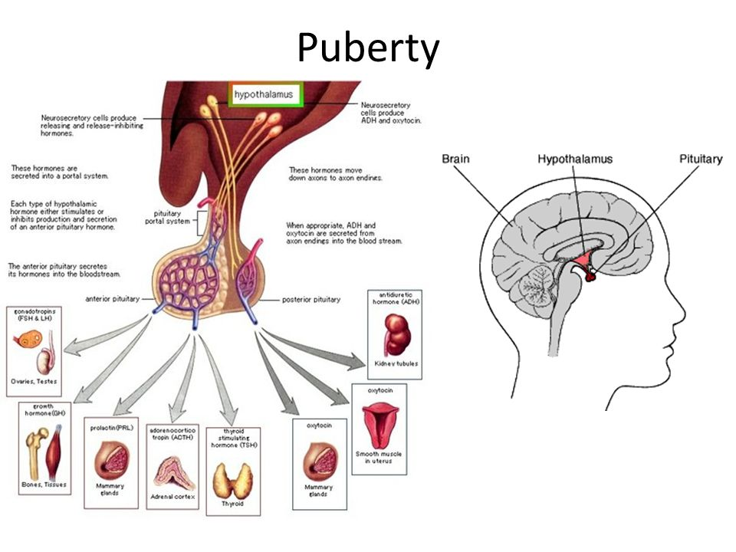
PHYSICAL DEVELOPMENT
There is rapid physical growth during this period of time.
Body changes
Gender Hormones
Gender Differences
Sexual Development Vs. Gender Identity
(Hopkinsmedicine.org, 2020; Standfordchildrens.org, 2020)
Notes:
The trainer will discuss the aspects within physical development that are important during adolescence.
There is rapid physical growth during this period of time: the cascade of hormones during puberty begin different types of processes throughout the body. The hypothalamus is the part of the brain that controls the pituitary gland and the pituitary gland is the master gland of the body.
Body changes: adolescents grow at a very rapid rate; larger bodies, larger internal organs and stronger body scent. They also experience skin breakouts and change in voice tone.
Gender Hormones: Boys produce testosterone which begins production of semen, first erection and usually boys begin exploring themselves through masturbation. Girls produce estrogen hormones which begins the readiness of sexual maturity and usually girls begin their first menstrual cycle and breast growth during this time. Both sexes experience growth of pubic hair
Gender Differences: males and females slightly differ in onset of puberty
Boys beginning stage of puberty is from 9.5 to 14 years old.
Girls beginning stage of puberty is from 8 to 13 years old.

Slide 10
SEXUAL DEVELOPMENT
Adolescence prepares the body for reproduction.
Sexual Development Vs. Gender Identity.
Sexuality is a complex and fluid concept.
(Hopkinsmedicine.org, 2020; Standfordchildrens.org, 2020)
Notes:
The trainer should introduce the concept of sexual development and ensure the difference between development and Identity if clear.
Adolescence prepares the body for reproduction: during this period of time, the human body begins preparing to mature sexually and becomes ready for reproduction.
Sexual Development Vs. Gender Identity: Biological Sexual Development during adolescence is not the same as gender identity development. Bodily changes happen for males and females but that does not indicate their sexual preference.
The trainer should explain that sexuality is an important part of understanding puberty, as our sexuality is a key piece of our identity. Many people believe that the word sexuality is synonymous with sex. In reality sex or sexual behavior is only a small part of sexuality. Humans are sexual beings from womb to tomb.
Sexuality is s fluid concept:
The trainer should continue to the realm of sexual identity.
Biological Sex – an individual’s biological status as male or female.
Gender role - refers to the cultural expectations of male and female behavior, acting masculine or feminine. Expressive actions and/or behaviors that society connects with being male or female.
Gender Identity – identifying yourself as either male or female based on internal feelings (may be different from the biological sex).
Sexual Orientation – romantic attraction and feelings towards individuals of the same, opposite, or both sexes.

Slide 11
EMOTIONAL/COGNITIVE DEVELOPMENT
Areas of major development:
  Abstract thinking
  Sense of identity
  Independence
  Responsibility
  Moral reasoning
(APA, 2002; Raising Children Network, 2018)
Notes:
The trainer will introduce the aspects of emotional and cognitive development.
Areas of major development:
Abstract thinking: Children’s neurological changes help them conceptualize situations, going from “black and white” thinking to a complex understanding. This skills is necessary to plan for goals, think about the future and evaluate alternatives.
Sense of identity: Adolescence is a time that is crucial where an individual becomes aware of himself/herself. They think about themselves a lot, their experience, their values, their environment and how the world interacts with them to learn about how to behave, think and feel.
Independence: A sense of independence develops and it is a health trait as it is related to their self-confidence; they’re trying to practice surviving, managing life and choices on their own.
Responsibility: Adolescents are learning about responsibility for their actions. In early stages, they still have a hard time thinking about future consequences of risky behaviors.
Moral Reasoning: refers to ethical behavior. This atmosphere should reinforce the concept that racism, sexism, homophobia, ageism, and biases against persons with disabilities are inherently destructive to both the individual and society.
Influences

Slide 12
STAGES OF ADOLESCENCE
Notes:
The trainer should introduce the topic that will be discussed, Stages of Adolescence. The trainer should also tell the group that we will discuss early, middle and late adolescence in general. The trainer should emphasize that all children develop in different ways, some slower than others, and that’s normal.

Slide 13
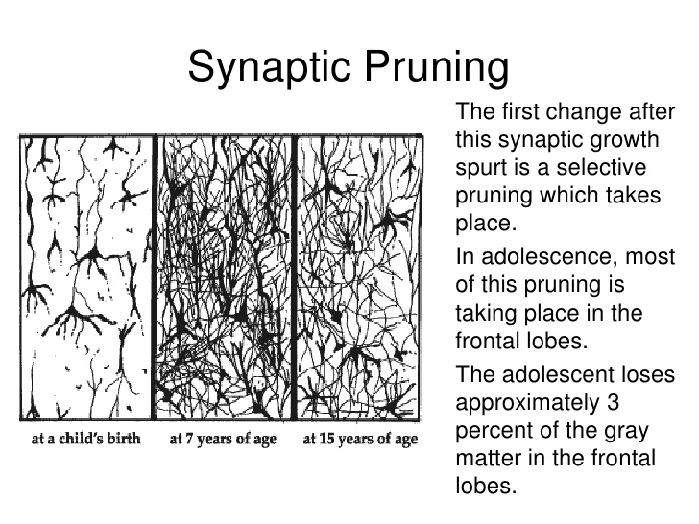
EARLY ADOLESCENCE
Early Adolescence occurs between
the ages of 10 – 14
  Fast physical growth.
  Brain begins intense shaping.
  Black and white thinking.
  Sense of identity
  Strongly identifies with peers.
  Higher need for privacy.
(Allen & Waterman, 2019; NPJS.org, 2015; Sukel, 2018)
Notes:
The trainer will introduce the brief overview of Early Adolescence (Ages 10 to 14).
Fast physical growth: During this stage, children experience rapid growth in their bodies. We discussed the physical changes before.
Brain begins intense shaping: The brain’s cells can almost double in over a year’s time period at this stage. The brain also begins a process called Synaptic Pruning; this eliminates synapses in the brain that are not necessary, and this is critical for health brain development. Neuroscientists have observed onset of serious mental illnesses at this stage such as schizophrenia.
Black-and-white thinking. Children experience “right/great” or “wrong/bad” thinking as they have not developed abstract thought.
Sense of identity: It is normal at this stage for young people to center their thinking on themselves (called "egocentrism"). They spend a lot of time thinking about themselves, their place in the world and expectations of them as they learn to figure out their sense of identity.
Strongly identifies with peers identifies strongly with a peer group in an attempt to recreate a substitute family.
Higher need for privacy. At this stage, children might become more independent and spend more time alone.
Adolescents are limited primarily by their brain development, so while they are struggling with the tasks they must accomplish, they don’t have the skills to do so in a healthy manner. Adolescents at this stage are very concrete, so that they are seeking new tasks but are grounded only in their own experiences to date, not what they may project. For example, in trying to separate from the family, that may look like just spending time away from the family, more with peers, more alone. As they are still limited, they seek what is familiar, so that if there is dysfunction in the family, it is likely that the peer group with which they identify mimics the same dysfunction. For example, if there is a dynamic of family violence, there is likely to be violence among their peers.

Slide 14

MIDDLE ADOLESCENCE
Middle Adolescence occurs between
the ages of 15 - 17
Physical changes continue.
Brain continues to change
Interest in romantic and sexual relationships.
Child-parent conflict
Higher concern for others & empathy
(Allen & Waterman, 2019; NPJS.org, 2015;NSP, 2009; Sukel, 2018)
Notes:
In this section the trainer will continue describing general changes in middle adolescence. This is a period of great conflict, as the young person continues to struggle to accomplish the tasks of adolescence, but now is becoming aware of his/her limitations. This result in frustrations, which can get projected onto the family or other authority figures. As such, adolescents will identify even more with their peers, while the family adjusts to the new stage in their own development. They are still grounded in what is concrete, so that they will demonstrate their separateness through dress, language, music, etc.
Physical changes continue: The body continues to grow and adapt to adulthood. At this stage girls usually have regular periods.
The brain continues to change: Much of this is because the frontal lobes are the last areas of the brain to mature―development is not complete until a person is well into their 20s! The frontal lobes play a big role in coordinating complex decision making, impulse control, and being able to consider multiple options and consequences. Middle adolescents are more able to think abstractly and consider "the big picture," but they still may lack the ability to apply it in the moment. For example, in certain situations, kids in middle adolescence may find themselves thinking things like:
"I'm doing well enough in math and I really want to see this movie… one night of skipping studying won't matter."
Do I really have to wear a condom during sex if my girlfriend takes the pill?"
"Marijuana is legal now, so it can't be that bad.“
Interest in romantic and sexual relationships: During this stage, teenagers begin to question their romantic preferences as well as their bodies through masturbation. Teens begin to develop feelings of attraction and live towards peers.
Child-parent conflict: They may spend less time with family and more time with friends, also tend to test limits from parents more.
Higher concern for others & empathy: At this stage, more complex thinking is achieved and teenagers are able to “put themselves in someone else’s shoes”, thus creating feelings of empathy.

Slide 15

LATE ADOLESCENCE
Late Adolescence occurs between
the ages of 18 – 24
Firmer sense of identity
Developed bodies
Invincible complex
Brain changes
(Allen & Waterman, 2019; NPJS.org, 2015;NSP, 2009; Sukel, 2018)
Notes:
At this stage, brain development has progressed and the need to ground oneself in the concrete begins to fade. The focus is on determining one’s new identity, in relationship to the family, the community and society as a whole. The trainer should ask for some examples of how young people begin to determine how to handle their separation from the family in terms of their identity, bringing the group back to the point that this stage doesn’t end at 18, but continues as the brain completes its development.
Ability to control impulses: Increased control over emotions and instant gratification is evident as they’re able to think more about the future, consequences and their life’s goals. Additionally, they’re able to conceptualize social and cultural norms and expectations and higher sense of identity.
Developed bodies: At this stage puberty has ended and bodies are fully developed and mature enough for reproduction.
Invincible complex: “It won’t happen to me” it is a frequent rational and behavioral response in adolescents. There is a desire to thrill-seeking and new adventures and thus more likely to try risky behaviors.
Brains changes: The last area to develop in adolescents in the pre-frontal lobes. This area must be stimulated by adults as reasoning ability is a learned skill. Having frequent “learning moments” to teach adolescents to conceptualize complex satiations and exercise imagination and possibilities can be extremely positive.

Slide 16
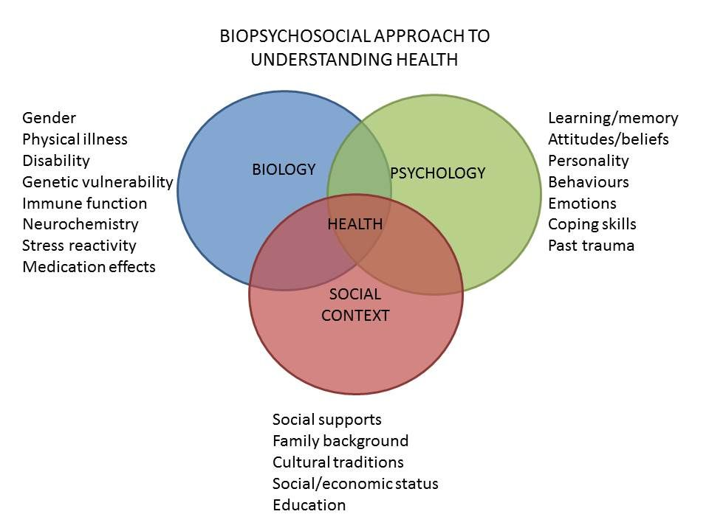
BIO-PSYCHO-SOCIAL MODEL
Notes:
The trainer should introduce the bio-psychosocial model of understanding substance use, explaining that it is not just an understanding of adolescent development needed to explain the relationship between youth and substance use. It is important to understand why and how substances work. An essential piece of understanding substance use is understanding its complexity. Substance use is not a simple behavior. It is related to several domains. S/he should explain the following:
Biological: The physicial factors which impact on the initiation, continuation or process of recovery from substance use
Psychological: The emotional factors which impact on the initiation, continuation or process of recovery from substance use
Social: The societal, cultural and community factors which impact on the initiation, continuation or process of recovery from substance use
The trainer should solicit an example of factors from each area. Then, s/he should break the participants into groups to brainstorm reasons why young people will use drugs – bio, psycho, and social. Each group should focus on one area, and work for approximately 10 – 15 minutes to identify all of the factors that address their particular aspect of the model, including those factors which impact on initiation, continuation and recovery.
After each group has completed working, they should choose a member of their group to present and explain what they brainstormed, and which have to do with initiation, continuation or recovery. After they have presented, the trainer should validate each group’s findings and pass on to the following slides.

Slide 17
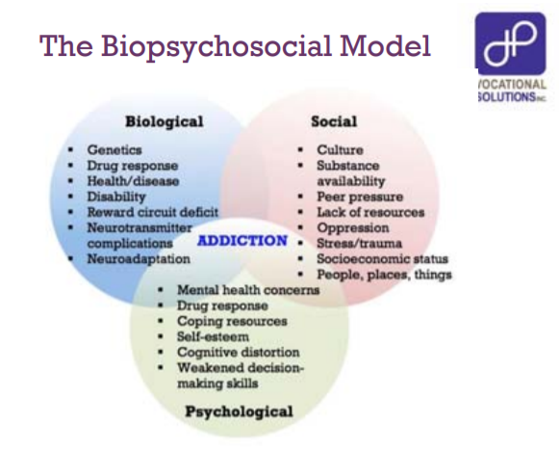
CAUSES OF SUBSTANCE USE THROUGH THE LENS OF THE BIO-PSYCHOSOCIAL MODEL
Biological
Psychological
Social
Notes:
The trainer should review the following set of slides regarding the bio-psychosocial reasons that people initiate and or/continue to use substances, soliciting examples of each reason. These may include alcoholism in the family, self-medication for physical and/or psychological pain, practical outcomes (increased energy or positive feelings), or learning negative coping mechanisms from family experiences.
Biological
1. Physically dependent
. Genetic predisposition
. Helps: get to sleep, with anxiety, with physical/emotional pain
. Decreases psychiatric symptoms
. Provides energy (i.e. caffeine, cocaine)
Psychological
1. Likes the buzz
. Treats feelings of depression
. Helps with feelings of inferiority
. Treats anxiety
. Increases confidence/self esteem
. Helps to forget problems
. Learned behavior
Social
1. Everyone does it
2. Family influence
3. Helps to fit in with peers
4. Way to socialize and meet people
5. Increases self-confidence so can meet others

Slide 18
CONSEQUENCES OF SUSBTANCE ABUSE
Social
Psychological
Biological
Notes:
The trainer should continue to review the bio-psychosocial model, now focusing on the problems that result when people use substances, focusing on the biological and psychological problems, and soliciting examples as before.
Biological
1. Death from overdose
2. Cancer, heart disease, strokes. Lung disease/Emphysema, accidents pneumonia, Diabetes, HIV/AIDS, suicide, chronic liver disease
3. High Blood Pressure
4. Toxic psychosis
5. Increased Tolerance
6. Withdrawal
7. Onset of other disabilities
Psychological
Depression
Decrease in self esteem/confidence
Not learn other ways to deal with stress and rewards
Self-hatred
Projected self-hatred onto family, friends and counselor
Social
Lose friends
Isolation
Friends who are users will support continued use
Increased possibility for psychopathology
Impact on family members and friends
Difficulties in school
Incarceration

Slide 19
CASE STUDY
In your small groups, analyze your case study of an adolescent in early stages of substance use, and identify all of the bio-psychosocial risk factors that are associated with this young person, including cultural issues.
Notes:
The trainer should explain that they will be examining a number of different cases of young people who are either starting to use substances or beginning to see the problems associated with substance use. S/he should break the group into smaller groups of 5 – 6 people, and distribute one case study to each group. Case studies can be found at the end of this module. The groups should work for 15 – 20 minutes to identify the bio-psychosocial factors that are associated with this young person’s substance use. Someone in each group should take notes and someone should be identified to present back to the larger group.
After the groups have had time to develop their lists of factors, each group should read their case study aloud to the larger group and present the bio-psychosocial factors they have identified with that particular young person. The trainer should process the exercise by asking the larger group if they are in agreement, if they identify any factors they feel were missed and thank the presenter from each group.
The trainer should then take a little time to summarize the exercise and relate it back to the slides that were reviewed prior to the case study.

Slide 20
THE ADOLESCENT BRAIN ON DRUGS

Slide 21
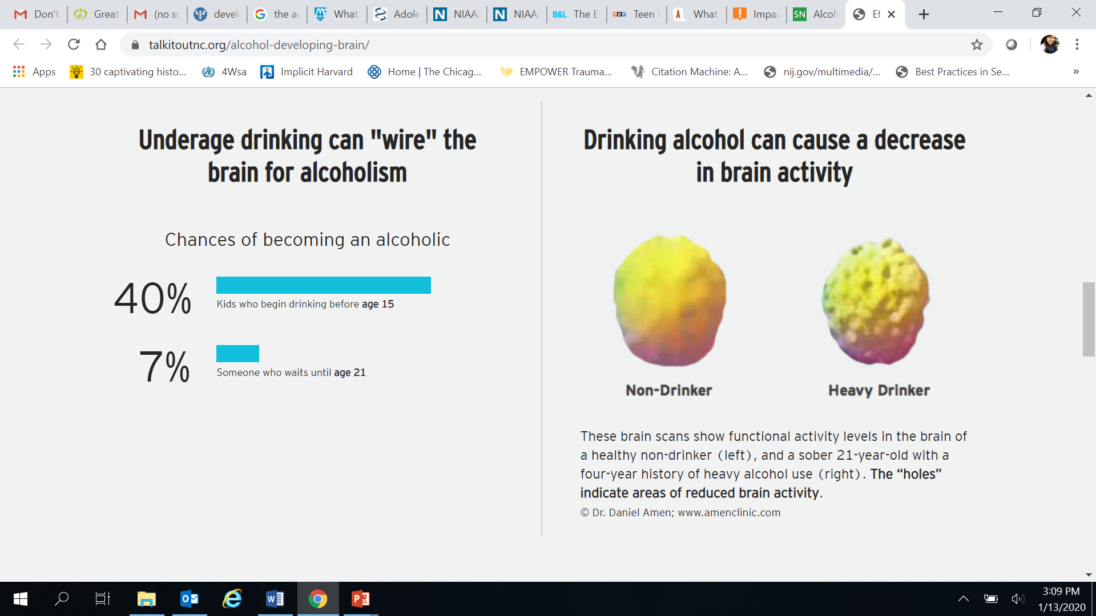
THE ADOLESCENT BRAIN ON DRUGS: ALCOHOL
It is paramount to discourage substance use until neurobiological development is complete.
Underage drinking can wire the brain for alcoholism.
Prolonged alcohol use during adolescent can cause irreversible damage.
(Amen Clinics, 2020; Silvery, 2012; Risher et al, 2015; Talkitoutnc.org, 2020)
Notes:
The trainer will introduce how certain drugs affect the brain. The trainer should explain that substance use hijacks the brain’s “wiring.” This wiring is responsible for everything from low level function, such as major movements, to high level function, such as decision-making and judgment.
It is paramount to discourage substance use until neurobiological development is complete: research strongly suggest the brain is impacted by early use of substances. Even substances like Alcohol which are legal at age 18 can impact adolescent’s cognitive abilities and decision-making capacity. Neurological damage has been observed in brain connections (synapses).
Underage drinking can wire the brain for alcoholism: Research suggest that when adolescents use alcohol, 90% of the time is it by binge drinking. This type of drinking causes major impairment and increases the likelihood of becoming an alcoholic by 40%. Prolonged drinking causes brain inflammation.
Prolonged alcohol use during adolescent can cause irreversible damage: research suggests that nerve cells in the brain are immature throughout adolescence and past the min-20s. Using Alcohol for a prolonged period of time during a crucial developmental time causes irreversible damage; those who drink more lose more white matter which helps send messages quicker and for longer distances within the brain.

Slide 22
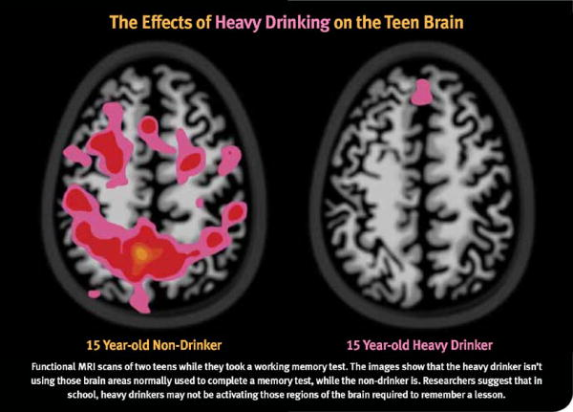
(Paturel, 2012)
Notes:
The trainer should explain that the image represents two teenagers; one a heavy drinker on the right and a nondrinker on the left. They are both working on a memory test. It is evident that areas in the heavy drinker brain are not active, thus performance is lower and the task can be viewed as too difficult.
Researchers suggest that in school, heavy drinkers may not be activating those regions of the brain required to remember a lesson.

Slide 23
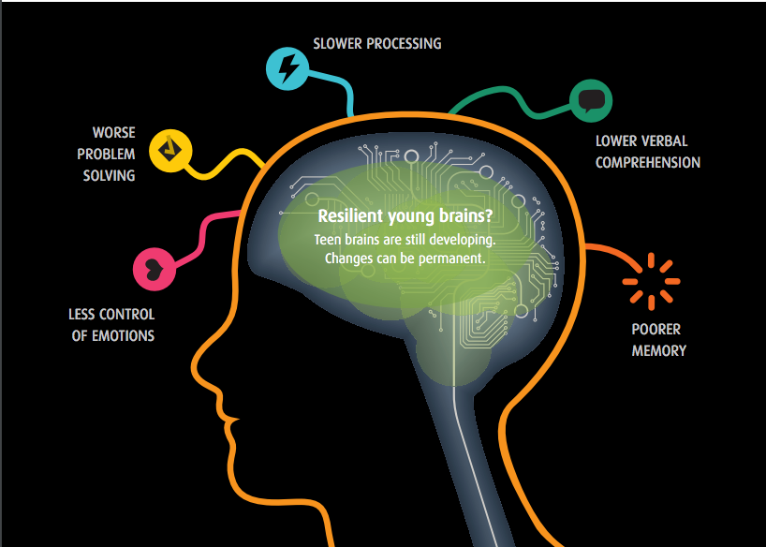
THE ADOLESCENT BRAIN ON DRUGS: MARIHUANA
Most utilized illicit drug.
Impairs brain systems.
Poor mental health
Gateway drug.
(APA, 2015; Drugabuse.gov, 2019; Orr et al, 2019; HHS.gov, 2018)
Notes:
The trainer will discuss the impact of marihuana use on the developing brain.
Most utilized illicit drug: Marihuana is quickly becoming more accepted in societies through the legality of it in many contexts. Although this drug has provided evidence of positive effects treating terminal illnesses, pains and seizures, the risks for this drug on the developing brain for regular use are concerning.
Impairs brain systems: In the short term, marijuana use has been shown to impair functions such as attention, memory, learning and decision-making. Use of marihuana is linked to impairment of critical systems that help the brain shape and grow, these systems are linked to emotions and response to stress. A study of 46 brains of 14 year old children found enlarged gray matter which contradicts adolescent development by disrupting the synaptic pruning process.
Poor mental health: Additionally, marihuana use is linked to learning problems, lower IQ and increased suicidal attempts. Recent genetic studies have found long-term users’ specific genes are affected that place them at higher risk of mental health issues.
Gateway drug: there is a 130% likelihood that an adolescent using marihuana regularly will also use opioids.

Slide 24
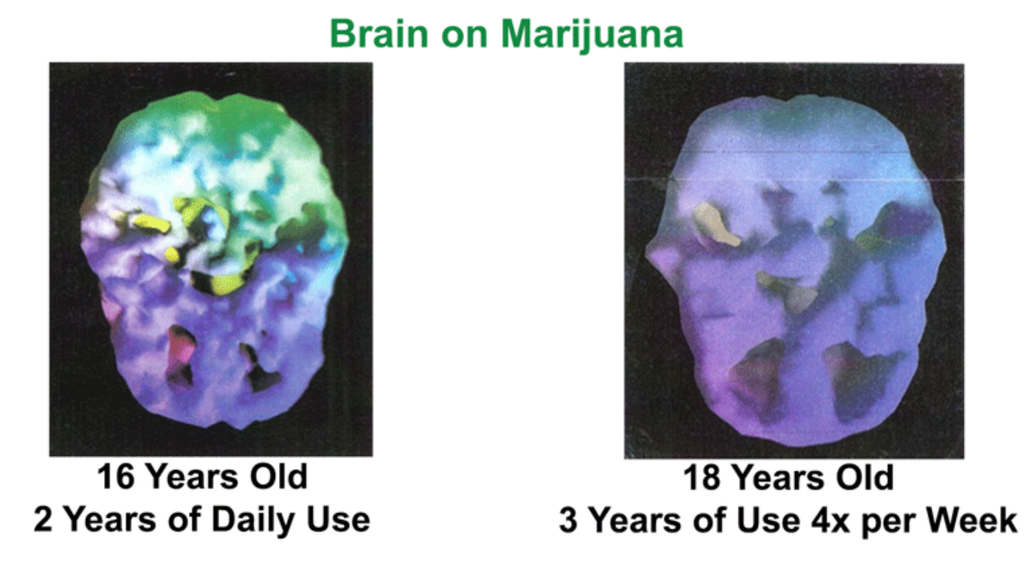
(Lodiaction.org, 2020)

Slide 25
PREFRONTAL CORTEX AFFECTED AREAS
Controlling impulses
Inhibiting inappropriate behavior
Initiating appropriate behavior
Stopping an activity on completion
Shifting/Adjusting behavior when situation changes
Providing a temporary workspace for working memory
Organizing things
Planning behavior
Setting priorities among tasks and goals
Making decisions
Empathy
Sensitivity to feedback (reward and punishment)
Insight
Notes:
The trainer should review all of the functions of the prefrontal cortex, soliciting examples as to how this function might impact on initiation or continuation of substance use. For example, the ability to control impulses can impact on both initiation, with the impulse of curiosity or reaction to peer pressure, as well as continuation, with the “reward” reaction that comes from a pleasurable experience under the influence of a substance.
Functions of Prefrontal Cortex
Controlling impulses
Inhibiting inappropriate behavior
Initiating appropriate behavior
Stopping an activity on completion
Shifting/Adjusting behavior when situation changes
Providing a temporary workspace for working memory
Organizing things
Planning behavior
Setting priorities among tasks and goals
Making decisions
Empathy
Sensitivity to feedback (reward and punishment)
Insight

Slide 26
DEVELOPMENTAL WELLNESS IN YOUTH
Notes:
The trainer will introduce the next section’s topic. The goal of this section is to learn about developmental factors that are necessary for youth wellbeing and providing the audience with tools to conceptualize an adolescents’ protective factors.

Slide 27
DEVELOPMENTAL ASSETS
The Developmental Assets® are 40 research-based, positive qualities that influence young people’s development, helping them become caring, responsible, and productive adults.
Based in youth development, resiliency, and prevention research, the Developmental Assets framework has proven to be effective and has become the most widely used approach to positive youth development in the United States and, increasingly, around the world.
The framework has been adapted to be developmentally relevant from early childhood through adolescence.
(Search-Institute.org, 2017)
Notes:
The trainer should explain that research has been conducted regarding the life skills areas that adolescents must have in order to succeed in difficult environments. As with resiliency theory, this model looks at why some young people are doing well, despite their circumstances that would put them at risk. The Search Institute, a research organization on youth development, has identified 40 characteristics, or assets, which support positive youth development, and strengthen adolescent’s ability to grow into healthy adults with the necessary skills to succeed.
The Developmental Assets® are 40 research-based, positive qualities that influence young people’s development, helping them become caring, responsible, and productive adults. Based in youth development, resiliency, and prevention research, the Developmental Assets framework has proven to be effective and has become the most widely used approach to positive youth development in the United States and, increasingly, around the world. The framework has been adapted to be developmentally relevant from early childhood through adolescence.

Slide 28
DEVELOPMENTAL ASSETS
SUPPORT:
Family Support
Positive Family Communication
Other Adult Relationships
Caring Neighborhood
Caring School Climate
Parent Involvement in Schooling
EMPOWERMENT:
Community Values Adolescents
Youth as Resources
Service to Others
Safety
(Search-Institute.org, 2017)
Notes:
The trainer should review the different areas or factors that impact on positive youth development – those assets identified by the Search Institute as supporting healthy bio-psychosocial growth. The first area of assets to be reviewed are those that are external assets, in other words, assets which are not dependent on the adolescent him/herself.
External Assets: Support
Family Support | Family life provides high levels of love and support.
Positive Family Communication | Young person and her or his parent(s) communicate positively, and young person is willing to seek advice and counsel from parents.
Other Adult Relationships | Young person receives support from three or more nonparent adults.
Caring Neighborhood | Young person experiences caring neighbors.
Caring School Climate | School provides a caring, encouraging environment.
Parent Involvement in Schooling | Parent(s) are actively involved in helping the child succeed in school.
The trainer should continue to review the external assets, this time in the area of empowerment.
External Assets: Empowerment
Community Values Adolescents | Young person perceives that adults in the community value adolescents.
Adolescents as Resources | Young people are given useful roles in the community.
Service to Others | Young person serves in the community one hour or more per week.
Safety | Young person feels safe at home, school, and in the neighborhood

Slide 29
DEVELOPMENTAL ASSETS
BOUNDARIES AND EXPECTATIONS:
Family Boundaries
School Boundaries
Neighborhood Boundaries
Adult Role Models
Positive Peer Influence
High Expectations
CONSTRUCTIVE USE OF TIME:
Creative Activities
Youth Programs
Religious Community
Time at Home
(Search-Institute.org, 2017)
Notes:
The trainer should continue to review the external assets, this time in the area of boundaries and expectations.
External Assets: Boundaries and Expectations
Family Boundaries | Family has clear rules and consequences and monitors the young person’s whereabouts.
School Boundaries | School provides clear rules and consequences.
Neighborhood Boundaries | Neighbors take responsibility for monitoring young people’s behavior.
Adult Role Models | Parent(s) and other adults model positive, responsible behavior.
Positive Peer Influence | Young person's best friends model responsible behavior.
High Expectations | Both parent(s) and teachers encourage the young person to do well.
The trainer should continue to review the external assets, this time in the area of constructive use of time.
External Assets: Constructive Use of Time
Creative Activities | Young person spends three or more hours per week in lessons or practice in music, theater, or other arts.
Youth Programs | Young person spends three or more hours per week in sports, clubs, or organizations at school and/or in community organizations.
Religious Community | Young person spends one hour or more per week in activities in a religious institution.
Time at Home | Young person is out with friends "with nothing special to do" two or fewer nights per week.

Slide 30
DEVELOPMENTAL ASSETS
COMMITMENT TO LEARNING:
Achievement Motivation
School Engagement
Homework
Bonding to School
Reading for Pleasure
POSTIVE VALUES:
Caring
Equality and Social Justice
Integrity
Honesty
Responsibility
Restraint
(Search-Institute.org, 2017)
Notes:
The trainer should then go on to explain the internal assets, in other words, skills and capacities that a young person exhibits or develops in various sectors. The first area for review is commitment to learning.
Internal Assets: Commitment to Learning
Achievement Motivation | Young person is motivated to do well in school.
School Engagement | Young person is actively engaged in learning.
Homework | Young person reports doing at least one hour of homework every school day.
Bonding to School | Young person cares about her or his school.
Reading for Pleasure | Young person reads for pleasure three or more hours per week.
The trainer should continue to review the internal assets, this time in the area of positive values.
Internal Assets: Positive Values
Caring | Young Person places high value on helping other people.
Equality and Social Justice | Young person places high value on promoting equality and reducing hunger and poverty.
Integrity | Young person acts on convictions and stands up for her or his beliefs.
Honesty | Young person "tells the truth even when it is not easy.“
Responsibility | Young person accepts and takes personal responsibility.
Restraint | Young person believes it is important not to be sexually active or to use alcohol or other drugs.

Slide 31
DEVELOPMENTAL ASSETS
SOCIAL COMPETENCIES:
Planning and Decision Making
Interpersonal Competence
Cultural Competence
Resistance Skills
Peaceful Conflict Resolution
POSITIVE IDENTITY:
Personal Power
Self-Esteem
Sense of Purpose
Positive View of Personal Future
(Search-Institute.org, 2017)
Notes:
The trainer should continue to review the internal assets, this time in the area of social competencies.
Internal Assets: Social Competencies
Planning and Decision Making | Young person knows how to plan ahead and make choices.
Interpersonal Competence | Young person has empathy, sensitivity, and friendship skills.
Cultural Competence | Young person has knowledge of and comfort with people of different cultural/racial/ethnic backgrounds.
Resistance Skills | Young person can resist negative peer pressure and dangerous situations.
Peaceful Conflict Resolution | Young person seeks to resolve conflict nonviolently.
The trainer should continue to review the internal assets, this time in the area of positive identity.
Internal Assets: Positive Identity
Personal Power | Young person feels he or she has control over "things that happen to me."
Self-Esteem | Young person reports having a high self-esteem.
Sense of Purpose | Young person reports that "my life has a purpose."
Positive View of Personal Future | Young person is optimistic about her or his personal future.

Slide 32

Research-based factors that promote youth wellbeing & development
Recent research has identified five core spheres that significantly improve youth’s wellbeing and development.
(CSSP, 2020)
Notes:
The trainer will discuss each of the core concepts that promote youth wellbeing. The trainer should discuss the list under each domain and pick a few examples to ask the audience about how a particular statement can influence an adolescent’s choice to use substances.
Cognitive and Social Emotional Competence
developing executive function skills (e.g., considering potential consequences; seeing alternate solutions to problems)
engaging in self-regulating behaviors (e.g., control of thinking and feelings; staying on task in the face of distractions)
developing character strengths (e.g., persistence, gratitude, integrity)
experiencing positive emotions (e.g., joy, optimism, faith, compassion for others)
taking responsibility for one’s self and one’s decisions
developing self-awareness, self-esteem, self-efficacy, and self-compassion
committing to and preparing to achieve productive goals
having both positive images of the person one wants to become and negative images of the person one wants to avoid becoming, as well as plans to achieve the possible selves

Slide 33
YOUTH RESILIENCE
Stress Management and responding to crises well (stressors, challenges, or adversity) while at the same time building on individual characteristics, strengths, and interests aids the adolescent in gaining resiliency.
(CSSP, 2020)
Notes:
The trainer will discuss the concept of resiliency as it related to how it impacts youth’s wellbeing. The trainer will discuss various statements below and provide examples. The trainer will emphasize that all these can be taught to adolescents and that in fact they must be taught during adolescent development.
Youth Resilience:
managing the stressors of daily life and functioning well when faced with challenges, adversity, and trauma
calling forth one’s inner strength to proactively meet personal challenges, manage adversities, and heal the effects of trauma
having a positive attitude about life and oneself
believing that one’s life is important and meaningful
becoming more self-confident and self-efficacious
having faith; feeling hopeful and optimistic
envisioning positive future possibilities
believing that one can make and achieve goals
working with purpose to achieve goals
facing challenges and making productive decisions about addressing challenges
seeking help when needed
thinking about and being accountable for one’s actions and the consequences of one’s actions
managing anger, anxiety, sadness, feelings of loneliness, and other negative feelings
learning from failure

Slide 34
SOCIAL CONNECTIONS
Networks of support and having healthy, sustained relationships with people, institutions, the community, and a higher power that promote a sense of trust, belonging, and a belief that one matters
(CSSP, 2020)
Notes:
The trainer will discuss the importance of how youth relate to their environment is fundamental to build positive networks of support.
Social Connections
Building a trusting relationship with at least one caring and competent adult who:
listens in a non-judgmental manner
is dependable/can be counted on
provides well-informed guidance, advice, and help in solving problems
promotes high expectations
sets developmentally appropriate limits, rules, and monitoring
provides emotional support (e.g., affirming good problem-solving skills)
provides instrumental support/concrete assistance (e.g., transportation)
provides informational support (e.g., post-secondary educational opportunities)
provides spiritual support (e.g., hope and encouragement)
provides an opportunity to engage with others in a positive manner
helps buffer youth from stressors
helps reduce feelings of isolation
promotes meaningful interactions in a context of mutual trust, respect, and appreciation
Being constructively engaged in social institutions (e.g., school, religious communities, recreational facilities) that are safe, stable, and equitable
Building a trusting relationship with positive, optimistic, mutually respectful peers who have similar values
Having a sense of connectedness that enables youth to feel loved, secure, confident, valued, and empowered to “give back” to others

Slide 35
KNOWLEDGE OF ADOLESCENT DEVELOPMENT
Learn about the physical changes during adolescence, especially about physical and neurological development, the impact of trauma, and identity development.
(CSSP, 2020)
Notes:
The trainer will discuss that when an adolescent becomes aware of the physical and neurological changes in their bodies that explain their moods, behaviors, thought-processes they feel more in control and are able to understand themselves and their place in the world.
Knowledge of Adolescent Development
Encouraging parents, adults who work with youth, and youth themselves to increase their knowledge and understanding about adolescent development
Seeking, acquiring, and using accurate information about:
adolescent brain development
physical and emotional changes that occur during puberty
one’s culture
societal rules, demands, expectations, and threats
one’s personal developmental history and needs, including one’s trauma history
sexual behavior, responsibility, choices, and consequences
essential life skills (e.g., managing money)
developing abstract thinking and improved problem-solving skills
developing a belief system and sense of morality
engaging in positive risk-taking and avoiding negative risk-taking
forging a personally satisfying identity
identifying productive interests, realistic goals, and steps to achieve goals
developing mature values and behavioral controls used to assess acceptable and unacceptable behaviors
building and sustaining healthy relationships with peers and adults
gaining independence from parents and other adults while maintaining strong connections with them

Slide 36
CONCRETE SUPPORT IN TIMES OF NEED
Understanding the importance of asking for help and advocating for oneself; receiving quality services (e.g., health care, housing, education) designed to preserve youths’ dignity, provide opportunities for skill development, and promote healthy development
(CSSP, 2020)
Notes:
The trainer will discuss the concept of developing adolescent’s self-advocacy skills and resourcefulness.
Concrete Support in Times of Need
being able to identify, find, and receive the basic necessities everyone deserves, as well as specialized services (e.g., medical, mental health, social, educational, or legal)
being resourceful
understanding one’s rights in accessing eligible services
navigating through service systems
seeking help when needed
being treated respectfully and with dignity when seeking and receiving services

Slide 37
COGNITIVE AND SOCIAL EMOTIONAL COMPETENCE
Acquiring skills and attitudes that are essential for forming an independent identity and having a productive, responsible, and satisfying adulthood
(CSSP, 2020)
Notes:
The trainer will discuss this concept which is one of the most important aspects that aid healthy adolescent development. As adolescents are learning these skills during a critical time, it should be emphasized that they need assistance with these concepts from adults in their lives.
Cognitive and Social Emotional Competence
developing executive function skills (e.g., considering potential consequences; seeing alternate solutions to problems)
engaging in self-regulating behaviors (e.g., control of thinking and feelings; staying on task in the face of distractions)
developing character strengths (e.g., persistence, gratitude, integrity)
experiencing positive emotions (e.g., joy, optimism, faith, compassion for others)
taking responsibility for one’s self and one’s decisions
developing self-awareness, self-esteem, self-efficacy, and self-compassion
committing to and preparing to achieve productive goals
having both positive images of the person one wants to become and negative images of the person one wants to avoid becoming, as well as plans to achieve the possible selves

Slide 38
SUMMARY
Adolescence is a confusing and stressful time for children.
Adolescent development is a process that begins roughly at 10 and ends in the mid-20s.
Substance abuse during adolescence has a negative impact on brain development.
Adolescents are still highly dependent in environmental factors to support them and teach them good choices.
Notes:
The trainer will summarize the most important information from module two.
Adolescence is a confusing and stressful time for children.
Adolescent development is a process that begins roughly at 10 and ends in the mid-20s.
Substance abuse during adolescence has a negative impact on brain development.
Adolescents are still highly dependent in environmental factors to support them and teach them good choices.

