Slide 1


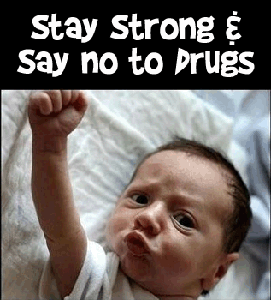
Persuasive Prevention:
Creating Evidence-Based Media Messages
William D. Crano, PhD
Professor of Psychology & Director,
Health Psychology and Prevention Science Institute
Claremont Graduate University

Slide 2
Relatively bleak history for demand reduction campaigns
Combined effects of supply and demand reduction efforts over the years, after many billions of dollars expended in the U.S.

Slide 3
The Issues
Mass Media have been irregularly successful in prevention of psychotropic substance use
Successful campaigns are good value
Failed campaigns are intolerably expensive
Inevitably, failed campaigns have ignored evidence on persuasion, resulting in use of unpersuasive preventive communications
PREVENTION ALWAYS INVOLVES PERSUASION

Slide 4

Let’s consider a memorable ad from an early media campaign in the U.S.

Slide 5
Some questions the ad evoked
Yeah can I get a side of bacon with that?
Could you make that over easy?
Yes. Are you going to eat my brain? Because I’m really hungry...mostly from doing drugs.
No, that's a frying pan, and that's an egg. I think whoever wrote this ad is on drugs.
Etc. How about that S. Dakota campaign It only cost $.5 Mil
The Meth campaign was brought to you by the same people who produced this

Slide 6
OK SMARTASS, WHAT SHOULD I DO?
SOME STEPS in Persuasion
DON’T TRIVIALIZE THE ISSUE
Induce audience to pay attention to your message
Induce them to think about your message
Present information in way that is difficult to counter
Get buy-in and if possible, commitment to act
A single presentation doesn’t do much – rinse & repeat
Boost initial effect with “booster shots”
Not that➔ ➔ ➔ ➔ ➔

Slide 7
Our solution: The EQUIP Model, which integrates critical media and persuasion requirements for effective prevention
EQUIP highlights the key design features for successful media-based persuasion
It is based on 60 years of strong, well-established evidence

Slide 8
The Central Action Components of the EQUIP Model
Engage: Attract and maintain attention of your audience
Question: Raise question in mind of receiver about their pro-drug attitude
Undermine: Destabilize the attitude
Inform: Provide plausible replacement of existing belief
Persuade: Provide incentives for agreement with your message

Slide 9
Let’s Evaluate the Ad using EQUIP
  ENGAGE: Did it attract people’s attention? Yes, initially.
  QUESTION: Did it raise a question in viewers’ minds? No.
  UNDERMINE: Did it threaten existing beliefs & provide alternative? No.
  INFORM: Did it tell you how to avoid frying your brain? No.
  PERSUADE: Was it persuasive? No. It is telling me to avoid a drug, but not how to do it, or why I should… It will fail.
BUT, Americans remember the ‘this is your brain on drugs’ ad! Difference between memorability and persuasibility
Notes:
There is a difference between an ad’s memorability and its persuasiveness. This ad was memorable – but not persuasive.
This was a creative and memorable ad that satisfied only one of the EQUIP criteria - ENGAGE. As we might expect, evidence showed it had no preventive effect.

Slide 10
Important working assumptions
People do not always believe what they are told, especially when dealing with psychotropic substances.
We need to overcome their resistance to attain positive preventive effects
The first and major consideration: expect counter-arguments
The EQUIP can help overcome these defensive reactions
Notes:
There is considerable literature, built up over the past 6 decades that suggests what to do and how to do it
This literature fits perfectly with our EQUIP requirements, and facilitates our attempts to integrate preventive media with persuasion

Slide 11
Building on the EQUIP, when designing our persuasive message, we:
Make resistance difficult, impossible, or apparently unnecessary
Target or tailor the persuasive message to the susceptibilities of the audience – what do they care about?
When dealing with young adult audiences: Use message sources the care about – don’t let them take the easy way out – “He doesn’t know what he’s talking about…”

Slide 12
More specifics… “Dos & Don’ts”
  Do not over-promise or over-threaten:
  Fear arousing ads usually fail – Avoid them
  Unbelievable ads usually fail – Avoid them
  Exaggerated ads usually fail – Avoid them
  Whimsical ads usually fail – Avoid them
  Disgusting ads usually fail – Avoid them
  Current failures result in future failures by reinforcing resistance
  For young adults, involve opinion leaders as message sources, but choose carefully
  Try to create a norm of abstinence or avoidance

Slide 13
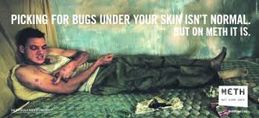
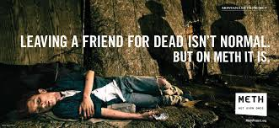
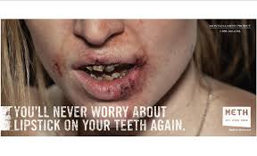
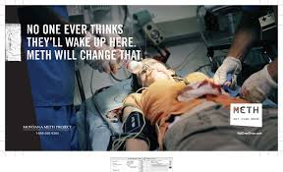
Fear arousing, exaggerated, unbelievable, disgusting ads

Slide 14

Thank you for your kind attention
Any Questions?
william.crano@cgu.edu

