Slide 1
QUALITY ASSURANCE
The Nigerian Experience
Akanidomo Ibanga – UNODC, Nigeria
&
Auwal Salihu – Aminu Kano Teaching Hospital, Kano

Slide 2
THE BACKGROUND
  The United Nations Office on Drugs and Crime (UNODC) Country Office in Nigeria is implementing a European Union funded project 'Response to drugs and related organized crime in Nigeria’.
  As part of this project, eleven drug treatment services attached to various hospitals in Nigeria have been established as Model Drug Treatment Centre’s
  In March 2015, an assessment of the centers was undertaken by UNODC and the Federal Ministry of Health (FMOH) based on ‘the National Minimum Standards for drug dependence treatment in Nigeria’ (2015).
  Standards for the treatment of drug use disorders were also developed in 2016.
  Treatment guidelines for treatment of substance use disorders in Nigeria were then developed in 2018
  As part of the European Union funded project 'Response to drugs and related organized crime in Nigeria’, funding for the development of a QA mechanism for drug use disorder treatment services was agreed.
Notes:
Community leaders, law enforcement officer, religious leaders, Government.

Slide 3
THE PROCESS
The overall training objectives for the workshop were: to capacity build a cohort of Nigerian DUD treatment experts in quality assurance; and, develop and agree a plan for the piloting of a QA mechanism for Nigeria in Kano State.
Facilitate a group of Nigerian experts in drug use disorder (DUD) treatment experts to develop and agree a subset set of Nigerian standards in DUD treatment services
      Nigerian standards,
      UNODC standards,
      Essential standards
Training of the expert group in service assessment, standard scoring, working with providers and quality improvement
Develop and agree a plan for the pilot testing of the standards and QA mechanism to be used in Kano State

Slide 4
QUALITY ASSURANCE ASSESSORS
Nigerian QA team took place in Lagos, Nigeria in March 2019
The team developed and agree a subset set of Nigerian standards in DUD treatment services
Received training in service assessment, standard scoring, working with providers and quality improvement.
Develop and agree a plan for the pilot testing of the QA instrument

Slide 5
The QA steps
27-29 March
Workshop to develop the QA instrument
April
Field testing of the QA instrument
May
Feedback from the testing of the QA instrument
20 May
Treatment facilities in the state approached and
informed of exercise to be carried out
10-15 July
QA exercise finalise scoring and draft reports
5-8 August
feedback to services, help with their
Development of an improvement plans
December
Further support/actions taken

Slide 6
THE INSTRUMENT

Slide 7
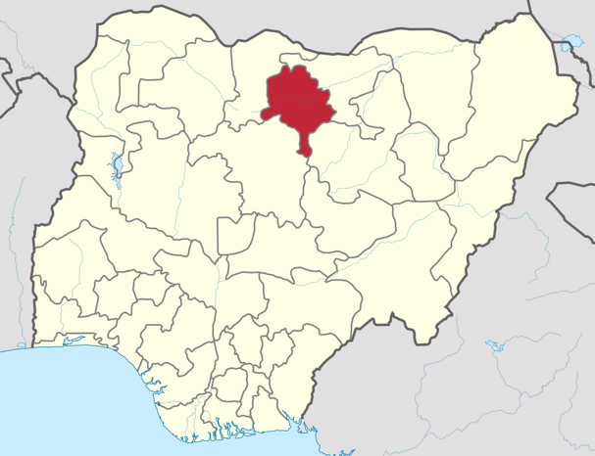
Selection of Kano State
It was a State that was more typical of Nigeria as a whole
the State had a number of State-run services that had attracted negative media attention in previous years
the State had experts in addiction treatment
Aminu Kano Teaching hospital and two members of the QA Expert group were based in the area and they had excellent connections with the State health system.
the North West geopolitical zone of the country. It is the second largest industrial centre

Slide 8
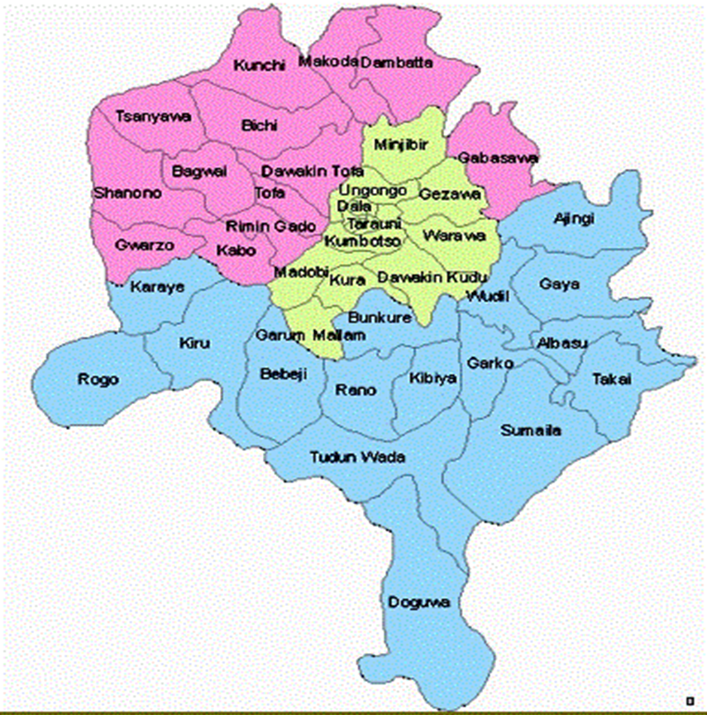
CENTRES PARTICIPATING IN THE QA EXERCISE

Slide 9
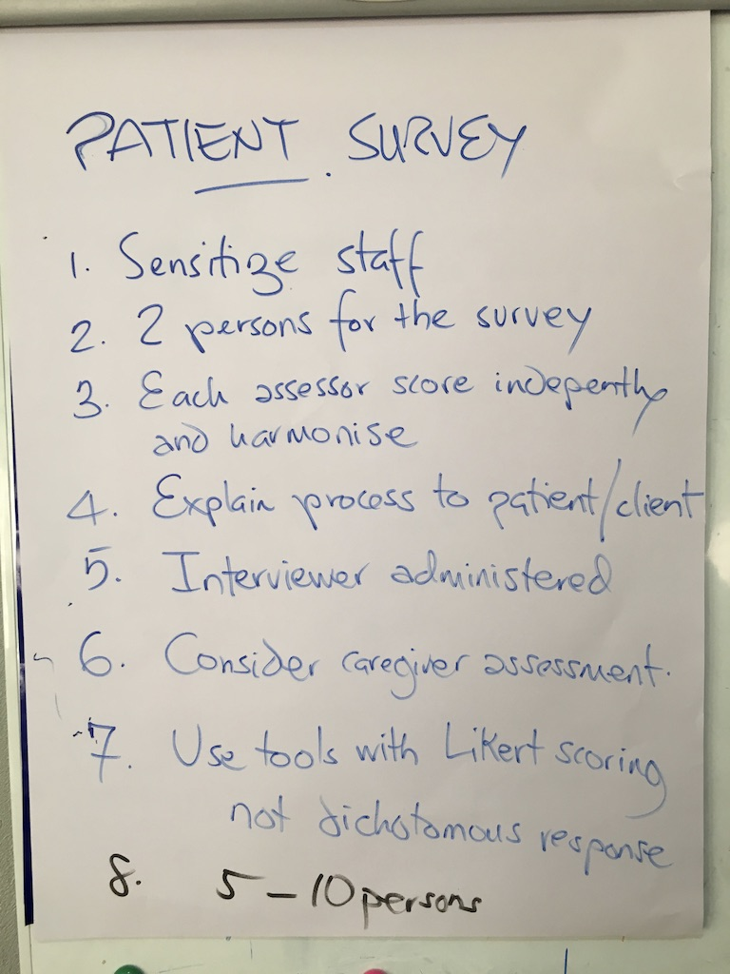
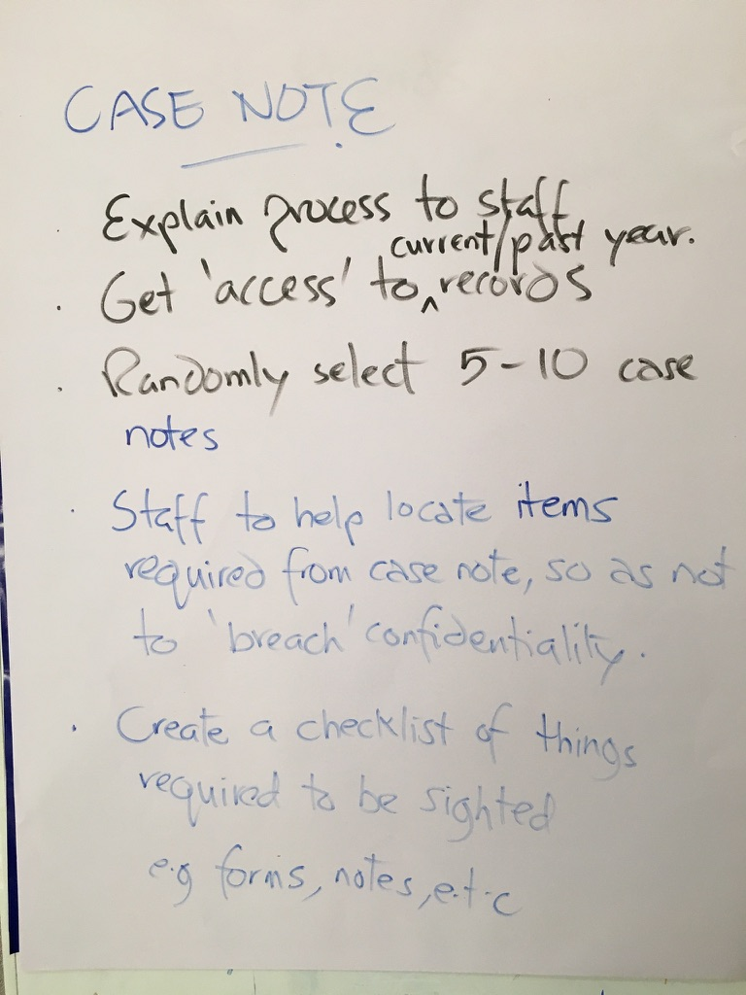
THE QUALITY ASSURANCE EXERCISE

Slide 10
FINDINGS OF THE QA EXERCISE
QA teams were unequivocally welcomed into the services and the managers of the services were very co-operative and willing to help
Almost all the centres are not specialist drug treatment services –.
He widespread use of restraint by chains or stocks
There were unconfirmed cases of clients being sexually abuse
.
Many of the services were extremely dirty and unhygienic
Lack of mental health treatment for clients with mental health problems.
Where medication was provided it was often by unqualified staff

Slide 11
FOLLOW UP ACTIONS TAKEN
Following the findings of widespread use of restraint of clients in chains or stocks, and issues concerning sexual abuse UNODC embarked on a more intensive course of action to those initially planned for the QA exercise. This included:
UNODC staff escalated reports of the alleged sexual abuse and restraint found within the pilot to senior UNODC colleagues
Contact was made with the management of the centres and the senior management of SEMA: the services in the QA pilot with reported sexual abuse and restraint with requests for additional visits and a meeting in early August.
Advocacy and briefing meetings were held with Kano State government and in particular, meetings with the senior management of SEMA, the HSMB to request immediate action and assistance to stop abuse and improve practice

Slide 12
FOLLOW UP ACTIONS (Contd)
Additional site visits were made to the women rehabilitation centres in the QA pilot
A two-day sensitisation training was held for the QA pilot site managers
Sites were supported to develop an improvement plan
Training for pilot site managers and staff in: mental health; substance use disorder prevention and treatment
Working with the HSMB and Kano State medical lead to ensure ongoing mental health ‘in-reach’ into the rehabilitation centres and secure resources to improve the facilities and living conditions for clients.
Commitment of UNODC to continue to supporting and following up on the centres

Slide 13
Implications of the QA exercise
Clarity about the scope of the QA
Revision of the QA mechanism and tools in light of the pilot
Capacity building current QA experts
Future roll-out of QA mechanism in Nigeria

