Slide 1

SEPTEMBER 2021: NATIONAL RECOVERY MONTH!
“Recovery is for Everyone: Every Person, Every Family, Every Community,”

Slide 2
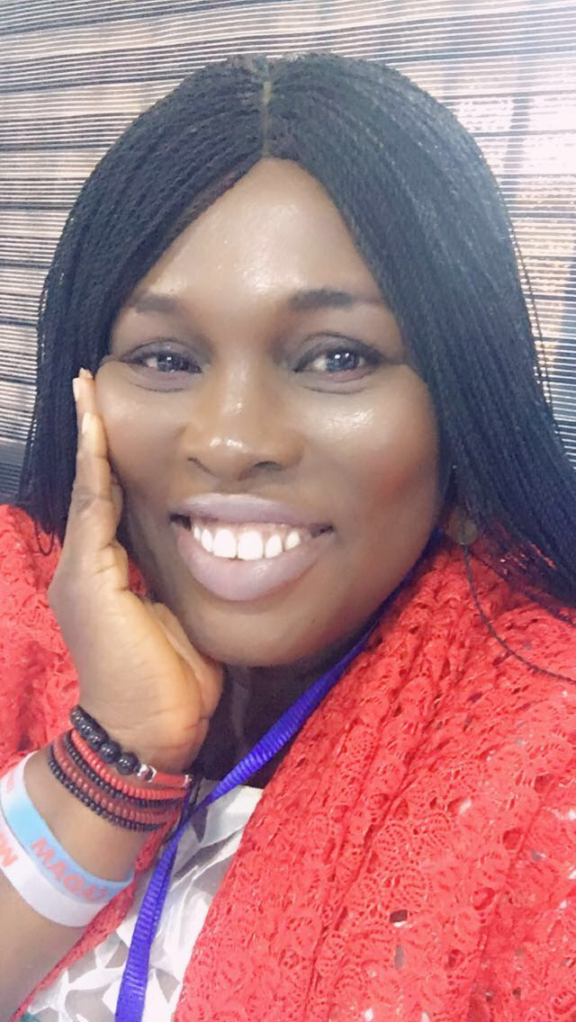
"Multidimensional Approaches to Addiction Recovery in South-West Nigeria."
Bekederemo Angela (LCSW)

Slide 3
Learning Objectives
Enhancing the need for a multi-dimensional recovery approach in our communities and actively address the diversity in recovery.
Emphasizing the fact that Client’s Recovery Plan should be tailored to suits the individual’s need.
Understanding that Addiction is not a Moral Failing
Stressing that Recovery is not a One Stop Designation, rather it is a Progressing Journey.
Recovery is for everyone, every person, every family, every community and it is very possible.

Slide 4
Addiction is Not a Moral Failing
It is not a moral failing or willpower, is a chronic and complex disease that have affect the brain’s reward system. There is the urgent need to provide and encourage treatment for persons with SUDs and offer continuous supports for those on the Recovery Path.

Slide 5
Anyone can be affected!
Substance use disorder (SUD) is a chronic disease that does not discriminate based on socioeconomic status, gender, age or race. And it’s more common than you may think.
The UNODC 2018, Drug Use in Nigeria Survey reported that 14.3 million persons have used substance in a lifetime. The statistic for Southwest Nigeria, where Lagos is located; is said to be 4,382,000 with a prevalence of 22.4%.
1 in 7 persons (15-64) have used drugs aside tobacco and alcohol
1 in 5 persons using drug is a dependent.

Slide 6
Addiction as defined by SAMHSA
Substance use disorders occur when the recurrent use of alcohol and/or drugs causes clinically significant impairment, including health problems, disability and failure to meet major responsibilities at work, school or home.
Studies have shown that 80% of persons who have received SUD treatment in a rehabilitation program have returned to drug/or alcohol.
Every individual is different, recovery is not a one size fits all. There are multiple ways to recovery, and these should be considered on the individual’s recovery journey.
Study on recovery community organization participants over time shows peer-based recovery support activities are associated with modest improvement in recovery capital.

Slide 7
The Need for Continuum Care
In South-West Nigeria, there is a clear gap meeting the needs for treatment and continuum care for persons with substance use disorders.
The non-accessibility of Recovery Services for persons post Treatment and Rehabilitation, and the STIGMA associated to Recovery Persons have made Recovery in Nigeria an uphill process.
Most Recovery Persons are very skeptical to identify with others on the Recovery Journey in order avoid been shamed, labelled, judged , condemned or stigmatized.
Year by year, persons with SUDs, check themselves into Treatment Facilities to overcome Addiction; so, aftercare services for Recovery Persons in Nigeria is very essential, if explored from a multidimensional approach.

Slide 8
Good News!
Recovery is beyond the absence of drug and alcohol.
Beyond going through substance use disorder treatment.
It is a long-term process of learning to live life and solve problems without drug and alcohol.
SAMSHA defined Recovery as a process of change through which people improve their health and wellness, live self-directed lives, and strive to reach their full potential.
Recovery is Not one size fits all! There are multiple parts to Recovery, and it is a voluntary process, meaning recovery persons designed their recovery plans; according to their needs.

Slide 9
Currently available Recovery Programs in South-West Nigeria
Weekly maintenance and psychotherapy meetings at government owned treatment facilities for recovery persons.
Weekly home visits to recovery persons from social workers of the treatment and rehabilitation centre. (FBOs and NGOs).
Private independent recovery coaching and mentoring for recovery persons.
Alunmi programs for former beneficiaries of the rehab program.
Follow up with telephone calls to check on recovery persons at home.
Half-Way Homes for recovery persons who want to increase on their safety nets and decrease the risky relationships in their lives.

Slide 10
Hindrances of Recovery in Nigeria
Lack of knowledge and understanding of addiction, and how recover works.
Stigma
Families see recovery as a one ‘stop shop and destination’
Families do not accommodate slip, lapse and relapse because of the high cost of treatment.
Non-availability of Recovery Communities in Nigeria
Coded Support Group Meetings such as AA, NA, Recovery Meetings for Persons in Recovery.

Slide 11
Prospective Multidimensional Approaches to Recovery to be Explored in Nigeria
Post acute care in treatment facilities, the following after-care programs can help Recovery Persons state committed on their journeys.
Sober Living Homes (Half-Way)
Alumni Programs
Support Groups (12 Steps, AA, NA, Al-Anon, Dual Recovery Anonymous, Overeaters Anonymous, SMART Recovery)
On Going Therapy (In and Outpatient) services
Case Management: Case managers can help the Recovery Person help healthcare providers, assist with legal, childcare and housing issues, and sometimes function as guides, supporters, advocates or counselors to their clients.

Slide 12
Benefits of Recovery
The Recovery Person commits to a lifelong recovery plan in the areas of health, home, purpose and community.
Health (physical, physiological, psychological and substance use free)
Home (Having a safe and stable place to live, and well knitted with family members and friends)
Purpose (participating in meaningful activities, such as a job or school, volunteering, caring for your family, or being creative.
Community (building relationships and social networks that provide support, friendship, love, and hope. For many recovering from substance use this may mean rebuilding relationships that were impaired during illness).

Slide 13
Avoid Relapse in Recovery
Addiction relapse rates is quite similar with depression, high blood pressure, dieting.
A thoughtful recovery plan developed, would help clients utilize their relapse prevention skills reduces the chances for a return to drug or alcohol use. One primary function of aftercare is to help you understand how to effectively deal with triggers and steer clear of factors that increase the risk of returning to use.

Slide 14
Recovery Community Centre (Supports)
If there are different recovery communities that help recovery persons function effectively on their recovery paths, this would be very welcoming and encouraging persons in need. However, we do not have them commonly in Nigeria, if there are, they remain undisclosed and code to avoid stigma and shaming.
What we can do going forward, with empathy, reduce Stigma and start building Recovery Community Centres to support persons in recovery in our diverse settings.

Slide 15

GRACIAS
Questions

Slide 16
References
Drug Advisory Plan (DAP) of the Colombo Recovery Plan: The Universal Recovery Curriculum for ALLIES
Peer Recovery Centre for Excellence: Recovery Friendly Workplace TOOLKIT
Drug_Use_Survey_Nigeria_2019_BOOK.pdf (unodc.org)
Suzette Glasner-Edwards, PhD: The Addiction Recovery Skills Workbook
Drs. Rose Azuike and Tony Rapu: Substance Use Treatment in Nigeria: A case study of a non-profit rehabilitation centre.
The Recovery Village: Aftercare and Sober Living Programs.

