Slide 1
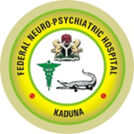
ISSUP NIGERIA 2025
THEME:
Exploring the Intersection of Substance Use and Mental Health: challenges and effective interventions
By
Hassan B. Salihu MD, FWACP

Slide 2
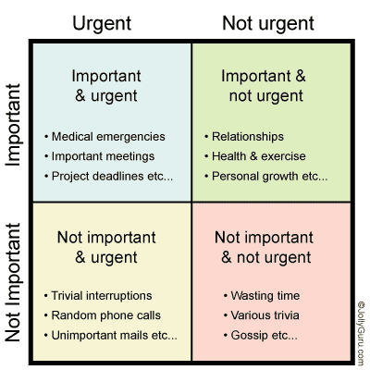

Slide 3
Learning OBJECTIVES
Understanding the Scope and Complexity
Recognizing Key Challenges
Exploring Effective interventions
Analyze Policy and Practice Implications
Foster Interdisciplinary and Culturally Competent Care
Commit To Action and Advocacy

Slide 4
Discussion Topics
Understanding the Dual Diagnosis
Gaps in Diagnosis and Access to Care
Stigma and Its Impact on Dual Diagnosis Treatment
Workforce Development and Training
Policy and Funding Priorities
Community Engagement

Slide 5
Relevance and Significance of the topic
High and Growing Prevalence
Costly Public Health Burden
Fragmentation of Care
Stigma and Social Injustice
Effective Solutions Exist but Are Underused
Alignment with Global Health Priorities

Slide 6
OUTLINE
INTRODUCTION
OVERVIEW OF MENTAL HEALTH AND SUBSTANCE USE DISORDERS
INTERCONNECTION OF SUBSTANCE USE AND MENTAL HEALTH
CHALLENGES AT THE INTERSECTION
EFFECTIVE INTERVENTIONS
RECOMMENDATIONS
CONCLUSION

Slide 7
Introduction
The co-occurrence of substance use disorders (SUDs) and mental health disorders presents a significant public health challenge, especially in LMIC country where individuals often face overlapping social, economic, and healthcare barriers.
Individuals affected often experience poorer health outcomes, higher service utilization, and increased mortality.
Fragmented care systems, stigma, and underfunding exacerbate these issues.

Slide 8
INTRODUCTION II
Co-occurring is also called comorbidity or dual diagnosis—when two disorders or illnesses occur in the same person, simultaneously or one after another.
Comorbidity also implies that the illnesses interact, affecting the course and prognosis of both.
Co-occurring conditions that involve SUD and mh are common because similar areas of the brain are involved with both.

Slide 9
Introduction III
About 50% of people with a mental health issue will also experience a substance use disorder and vice versa.
According to the National Survey on Drug Use and Health (2018), 9.2 million adults in the U.S. experienced both mental illness and a substance use disorder.
Rates are rising, particularly post-COVID-19, due to increased stress, isolation, economic uncertainty, and trauma.

Slide 10
Introduction IV
Mental health disorders can increase vulnerability to substance use, while substance use can precipitate or worsen mental illness.
Dual diagnoses are associated with increased hospitalizations, incarceration rates, homelessness, and suicide.

Slide 11
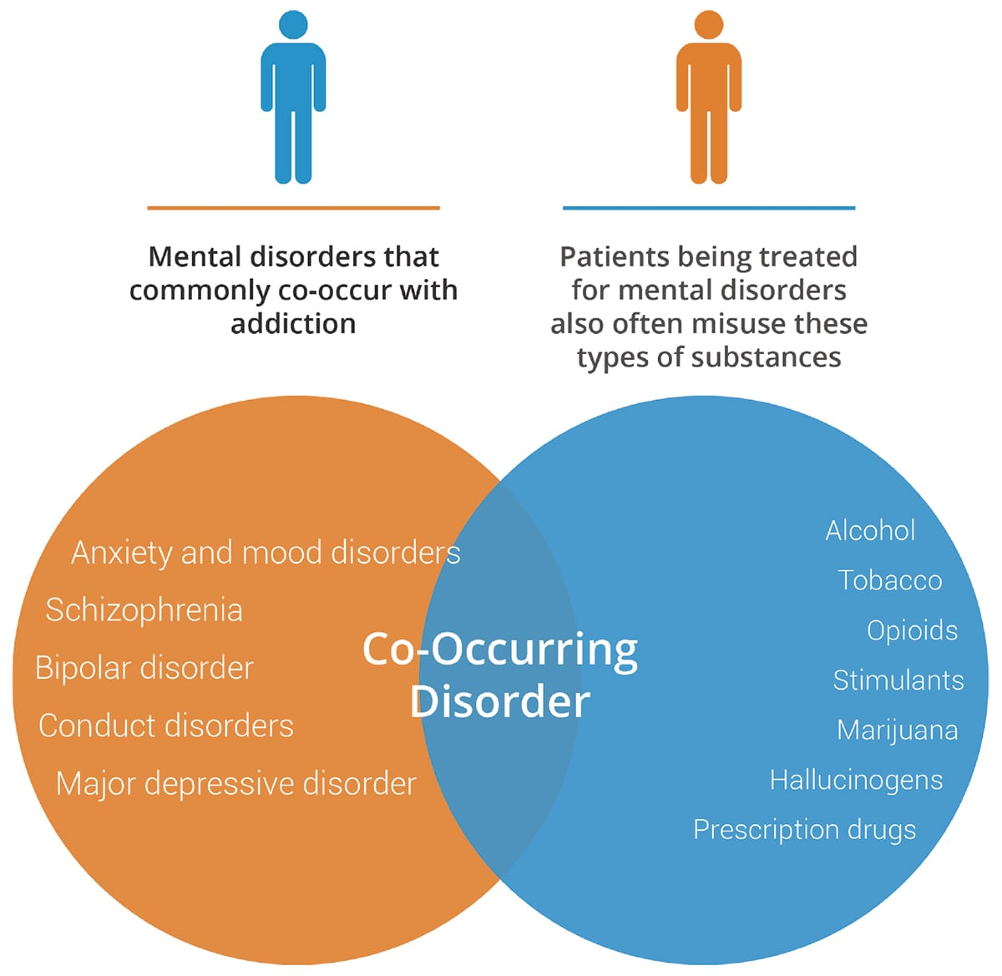

Slide 12
Overview: MH & SUD
Mental health : A state of well-being where individuals can cope with life's challenges, work productively, and contribute to their community.
It comprises psychological, emotional, and social well-being, affecting our moods, thoughts, feelings, behavior, relationships, and the way we handle stress.

Slide 13
Overview ii

Slide 14
overview iii
SUD: A persistent pattern of substance use that causes significant distress and impaired functioning, despite the individual's awareness of the harm caused by the substance.
It's characterized by compulsive substance seeking and use, even when faced with negative consequences, and a loss of control over consumption.

Slide 15
OVERVIEW 1V
Research has shown that mental disorders and SUD involve similar areas of the brain. The areas that process “reward” feelings and that respond to stress are affected by both disorders.
The interaction between substance use and mental health problems increases the severity of symptoms, reduces treatment efficacy, and complicates recovery.
Individuals with co-morbid disorders tend to have higher rates of relapse, longer treatment durations, and poorer overall outcomes compared to those with a single disorder.

Slide 16
INTERSECTION OF SUBSTANCE USE AND MENTAL HEALTH
Bidirectional relationship: Individuals with MH disorders may turn to substances as a form of self-medication, while substance use can trigger or worsen MH conditions.
Mental illness increases vulnerability to substance use: Brain changes in people with mental disorders may enhance the rewarding effects of substances.
Substance use exacerbating or triggering MH issues: Substance use may trigger changes in brain structure and function thus increase like hood to develop a mental disorder.

Slide 17
INTERSECTIONS II
Common overlapping risk factors:
Genetics
Trauma and adverse childhood experiences (ACEs)
Social determinants (e.g., poverty, homelessness, discrimination)
Neurobiological mechanisms

Slide 18
INTERSECTIONS III
Genetics: SUD and mental disorders are brain diseases; genetics can predispose an individual to addiction and can also put a person at higher risk for developing a co-occurring mental health issue.
Development: An adolescent brain that is still developing is at an increased risk for both addiction and mental health disorders.
Exposure: High levels of stress can trigger mental health disorders or SUD. Example; neglect, physical or sexual abuse, or other negative experiences the brain has difficulty processing.

Slide 19
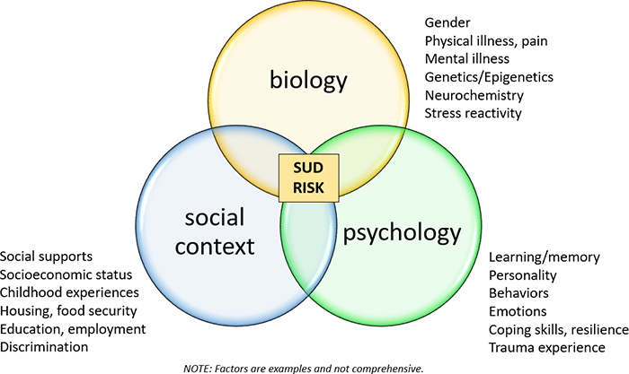

Slide 20
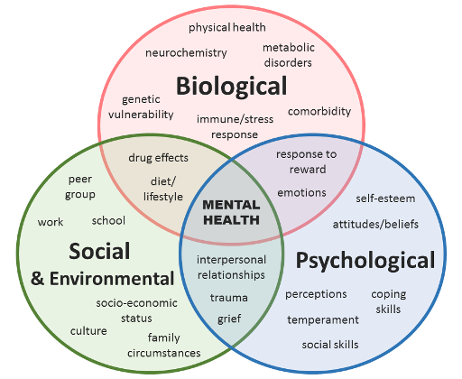

Slide 21
CHALLENGES AT THE INTERSECTION
Clinical challenges:
Diagnostic overshadowing
Complexity of assessment and treatment (Difficulty in diagnosing due to overlapping symptoms)
Poor prognosis if one disorder is untreated (Poor treatment adherence when one condition is left unaddressed)

Slide 22
CHALLENGES AT THE INTERSECTION ii
Systemic barriers:
Fragmented mental health and addiction services (Separate treatment systems for mental health and addiction)
Lack of integrated care models (Lack of integrated service models and case coordination)
Limited trained professionals

Slide 23
CHALLENGES AT THE INTERSECTION iii
Stigma and discrimination:
Dual stigma in health settings and society
Impact on help-seeking behavior
Policy and funding issues:
Insufficient investment in dual-diagnosis services
Inconsistent policy frameworks

Slide 24
EFFECTIVE INTERVENTIONS
Integrated treatment models: Persons who has SUD and another mental health disorder, should receive coordinated care for both conditions simultaneously
Early Intervention and Prevention.
Integrated Dual Disorder Treatment (IDDT): Is an evidence-based practice that improves quality of life for people with co-occurring severe mental illness and SUD by combining substance abuse services with mental health services.

Slide 25
EFFECTIVE INTERVENTIONS ii
IDDT: multidisciplinary with BIOPSYHOSOCIAL approach.
IDDT increases: Continuity of care, quality-of-life and Independent living as well reduces: Relapse and Hospitalization
Assertive Community Treatment (ACT): A form of community-based mental health care that emphasizes outreach to the community and an individualized treatment approach.

Slide 26
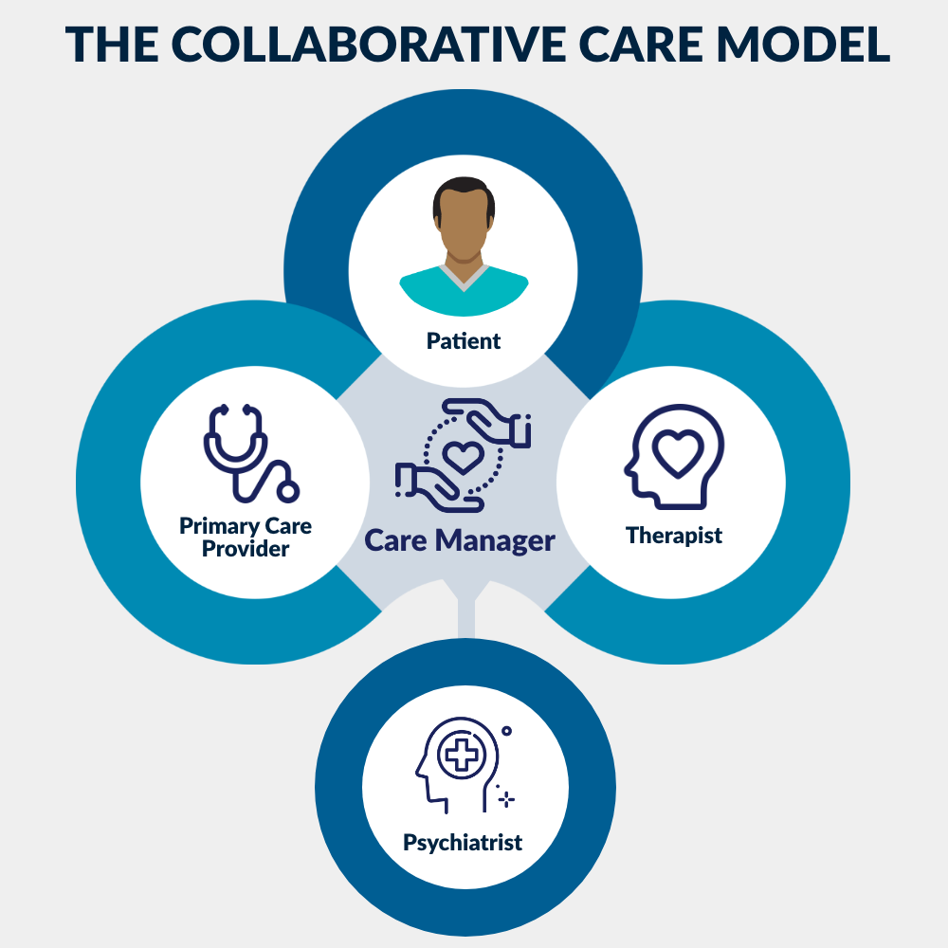

Slide 27
EFFECTIVE INTERVENTIONS III
Psychosocial interventions:
Cognitive Behavioral Therapy (CBT)
Motivational Interviewing (MI)
Contingency Management
Trauma-Informed Care
Dialectical behavior therapy (DBT)

Slide 28
EFFECTIVE INTERVENTIONS IV
Pharmacological interventions:
Medication-Assisted Treatment (MAT) for SUD (e.g., methadone, buprenorphine)
Psychotropic medications for co-occurring disorders

Slide 29
EFFECTIVE INTERVENTIONS v
Community-Based Support Systems: Providing access to peer support groups, family therapy, and community resources can help individuals build resilience and navigate recovery.
Harm reduction strategies: Needle exchange programs, and overdose prevention education.
Digital and telehealth approaches: E-therapy and mobile apps for mental health and addiction support

Slide 30
RECOMMENDATIONS
Promoting early detection and screening in primary care
Enhancing collaborative care and interdisciplinary teams
Strengthening training for providers on co-occurring disorders
Policy reforms for integrated service delivery, funding and investing in research
Community engagement and reducing stigma
Addressing Social Determinants of Health

Slide 31
RECOMMENDATIONS II
Culturally Competent and Tailored Interventions
Technological Innovations in Treatment Delivery

Slide 32
Conclusion
The intersection of substance use and mental health disorders particularly in vulnerable communities presents significant challenges that require a multifaceted, integrated approach to care and intervention.
Integrated care models, which provide simultaneous treatment for both mental health and substance use disorders, have shown significant success in breaking the cycle of these co-occurring conditions.

Slide 34
references
National Institute on Drug Abuse (NIDA). (2020). Common Comorbidities with Substance Use Disorders Research Report. https://www.drugabuse.gov
World Health Organization (WHO). (2014). Mental Health Atlas. https://www.who.int/publications/i/item/9789241565011
Substance Abuse and Mental Health Services Administration (SAMHSA). (2022). Integrated Treatment for Co-Occurring Disorders Evidence-Based Practices (EBP) KIT. https://store.samhsa.gov
United Nations Office on Drugs and Crime (UNODC). (2021). World Drug Report 2021: Drug use and health. https://www.unodc.org/unodc/en/data-and-analysis/wdr2021.html

Slide 35
https://case.edu/socialwork/centerforebp/practices/substance-abuse-mental-illness/integrated-dual-disorder-treatment
NIDA https://nida.nih.gov/research-topics/co-occurring-disorders-health-conditions
SAMHSA https://www.samhsa.gov/substance-use/treatment/co-occurring-disorders
NIDA https://www.drugabuse.gov/publications/drugfacts/comorbidity-addiction-other-mental-disorders
https://phoenixhouseca.org/addiction-mental-health/

